Slide 1


Slide 2

Lesson Essential Questions:
-Which types of items make up household hazardous waste and electronic waste
(E-Waste) ?
-Where can household hazardous waste and E-Waste be properly dispose of along with other hazardous items?
-What alternatives for cleaning are there instead of hazardous cleaning products?
S2
Notes:
Image Credit: https://nikkibush.com/being-able-to-ask-questions-is-at-the-heart-of-curiosity/

Slide 3

S3
Introduction – Engage / Explore
Let’s Explore Different Types Of
Household Hazardous Waste and E-Waste
Notes:
Image Credit: https://www.clker.com/clipart-2195.html

Slide 4
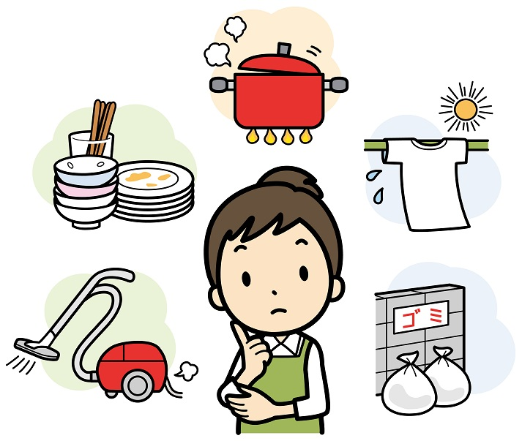
Keeping Your Room/Home Clean
S4
Which types of chores do you and your family do to help keep your room/home clean?
Notes:
Image Credit:
https://www.elephango.com/index.cfm/pg/k12learning/lcid/12026/Chores_Around_the_House

Slide 5
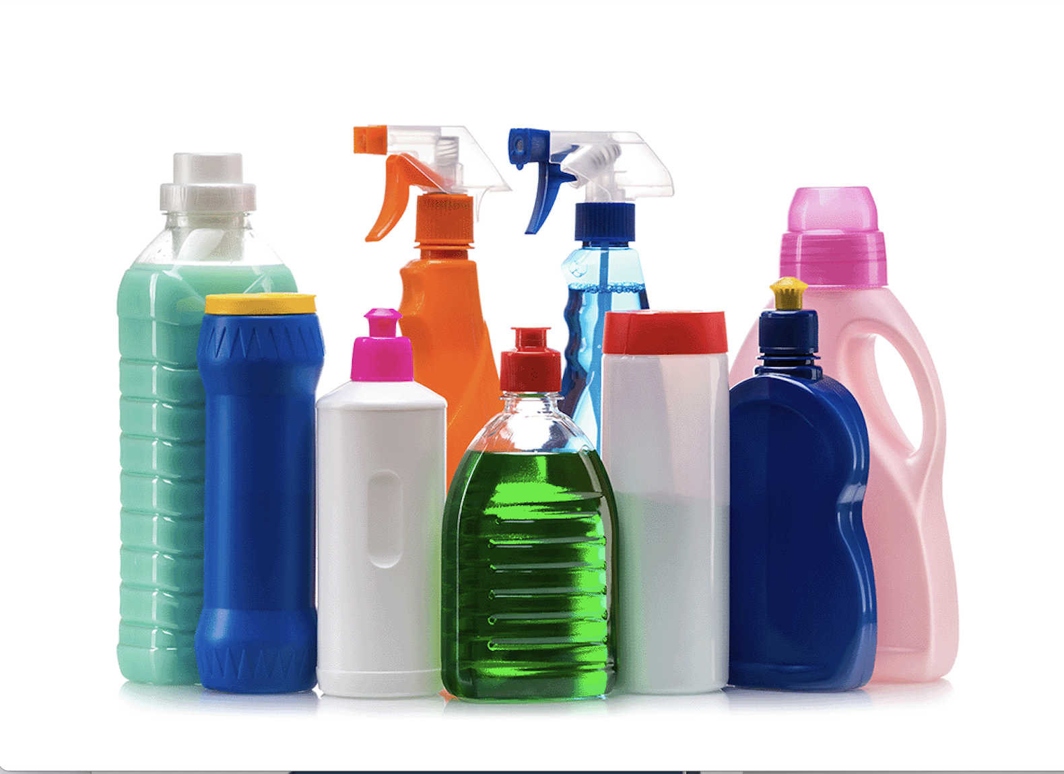
Keeping Our Room/Home Clean, cont.
S5
Are any cleaning products used to clean your home/room? If so, which ones?
Where are these types of products kept in your home?
Notes:
https://dpw.lacounty.gov/epd/cleanla/HHW.aspx

Slide 6
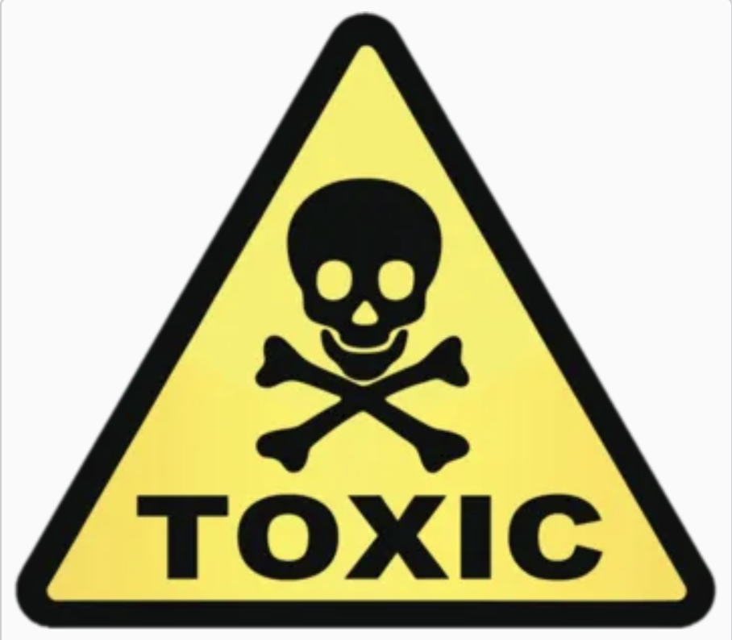

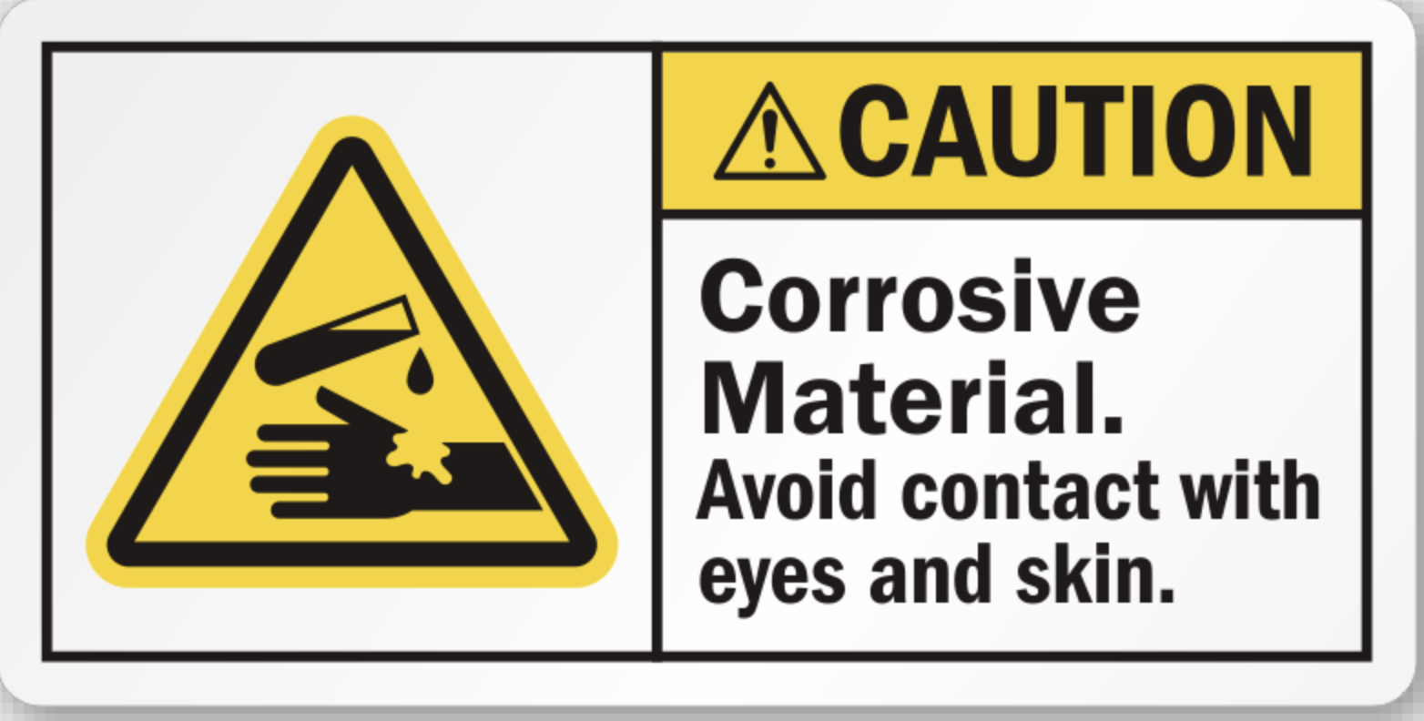
Teacher Explain: Household Cleaning Products Can Be Hazardous
S6
Many common household products contain chemicals that are harmful to humans, animals and the environment.
BE SAFE!
NEVER TOUCH THESE HARMFUL CLEANING PRODUCTS, THEY CAN HURT YOU. ALWAYS GET AN ADULTS HELP.
Have you seen these symbols before? If so, where? What do these symbols mean?
Notes:
Image Credits:
Toxic: https://tvtropes.org/pmwiki/pmwiki.php/Main/ToxicTropes
Corrosive Material: https://www.accuform.com/safety-sign/danger-corrosive-materials-danger-matires-corrosives-MCSA150
Danger Flammable: https://www.emedco.com/chemical-flammable-signs-danger-flammable-with-graphic-80390.html

Slide 7

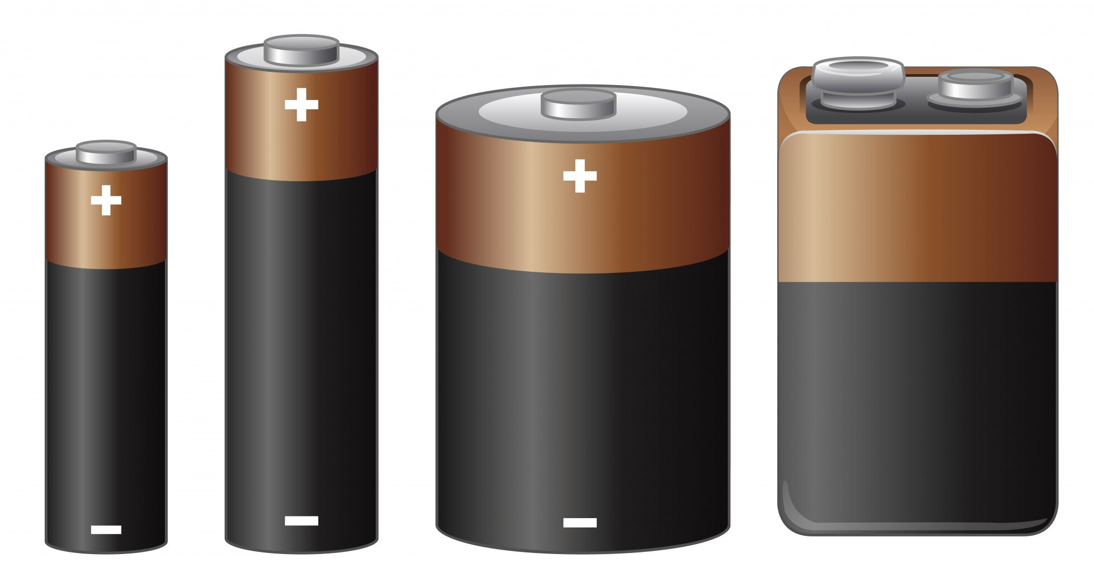

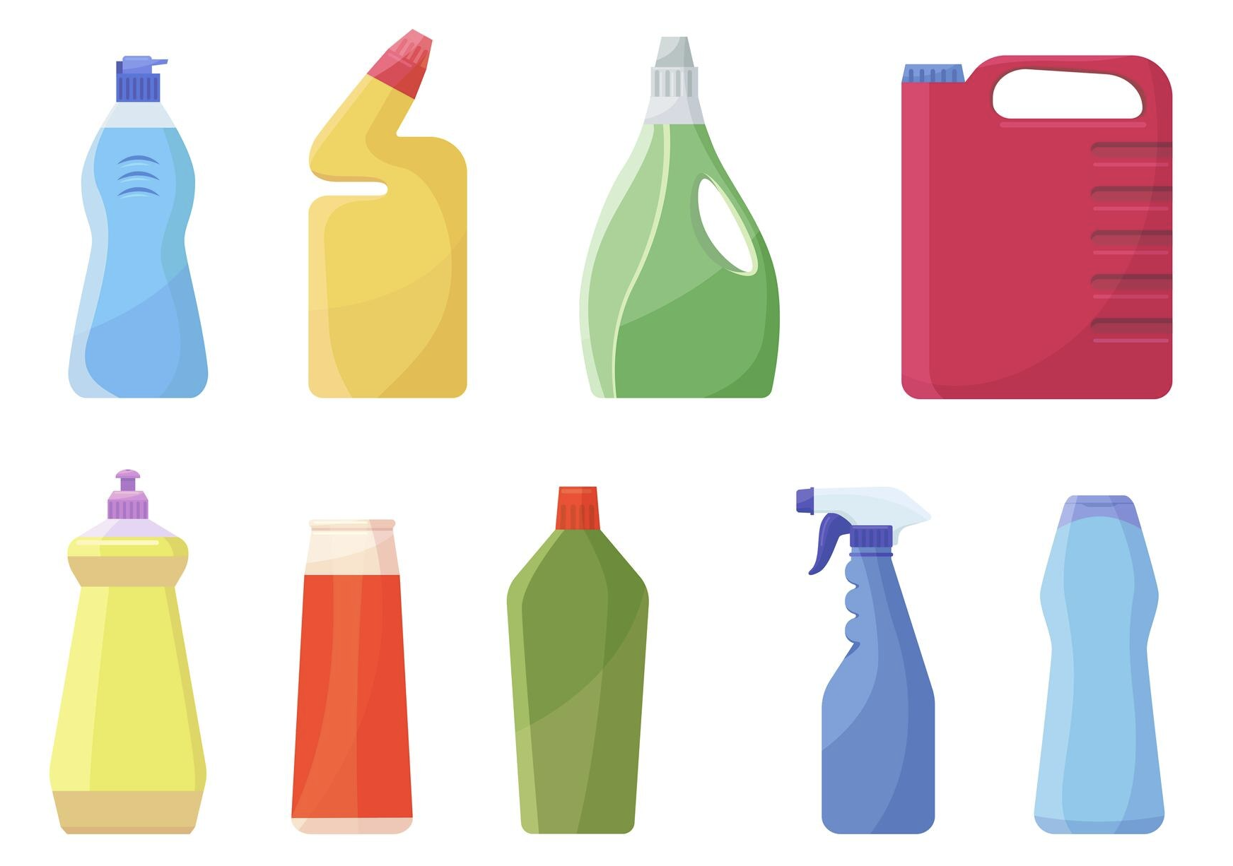
Getting Rid of Things You No Longer Need
S7
What do you or your family do with these items when they are no longer needed?
  Leftover cleaning products
  Leftover paint
  Used motor oil
  Electronics
  Batteries
  Sharps
  Pharmaceuticals
Notes:
Image Credits:
Pharmaceuticals:https://www.freepik.com/free-vector/medicine-bottles-cartoon-style_24064993.htm#query=jar%20pills&position=0&from_view=keyword&track=ais&uuid=5fa4f86d-6256-4b09-aea3-3e7382e1b6d5
CleaningProducts:https://www.freepik.com/free-vector/bleach-containers-set_13682971.htm#page=6&query=cleaning%20products&position=37&from_view=search&track=ais&uuid=9ac7285c-4d0b-4bbc-9148-274ad4edf107
Paint:https://www.freepik.com/free-vector/painting-tools-equipment-realistic-composition-with-paint-cans_2873569.htm#query=paint%20gallons&position=19&from_view=search&track=ais&uuid=3834e46b-d54d-4ab9-9d21-14c3109c0088

Slide 8
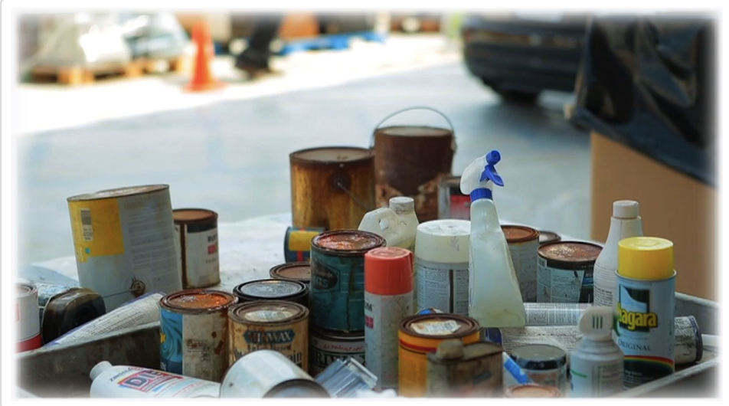
Teacher Explain: What is Household Hazardous Waste (HHW)?
S8
Any leftover products that are labeled toxic, poison, corrosive, flammable, combustible, or irritant that you want to discard is considered Household Hazardous Waste (HHW).
It is both DANGEROUS AND ILLEGAL to dispose of HHW in the garbage, down any drain, or on the ground.
Notes:
Image Credit: https://dpw.lacounty.gov/epd/hhw/Hhw

Slide 9
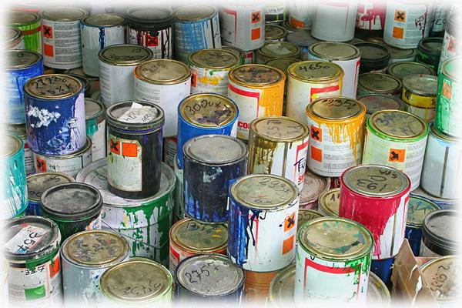
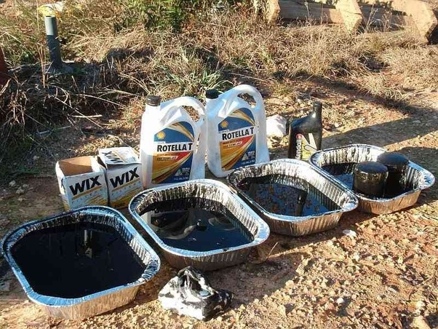
Teacher Explain: Other Items That Should Not Be Thrown In The Garbage, Down Any Drain, Or On The Ground …
S9
Leftover Paint
Used Motor Oil
Old paint may come in gallon cans, or in smaller cans such as quarts or pints.
Used motor oil can come from cars, trucks, motorcycles, boats, lawn mowers and other engines.
Notes:
Image Credits:
Paint: https://dpw.lacounty.gov/epd/hhw/Paint
Motor Oil: https://www.quora.com/What-are-the-consequences-of-disposing-of-motor-oil-by-dumping-it-on-the-ground-instead-of-taking-it-to-a-disposal-site-or-recycling-center

Slide 10

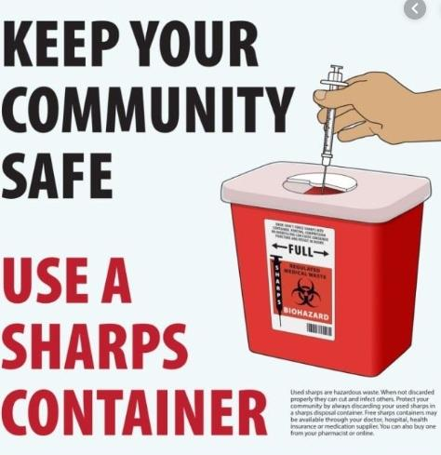
Teacher Explain: Other Items That Should Not Be Thrown In The Garbage, Down Any Drain, Or On The Ground
S10
Pharmaceuticals
Sharps
Pharmaceuticals include medicines that a doctor prescribes to you or medicines that are purchased at the store to help you feel better when you are sick.
Sharps are devices with sharp points or edges that can puncture or cut skin to help people manage medical conditions such as diabetes.
Notes:
Image Credits:
Pharmaceuticals: https://www.ikonmarket.com/market-research-report/pharmaceuticals-market-in-india-2020.html
Sharps: https://eph.org/know-how-to-properly-dispose-of-sharps/

Slide 11
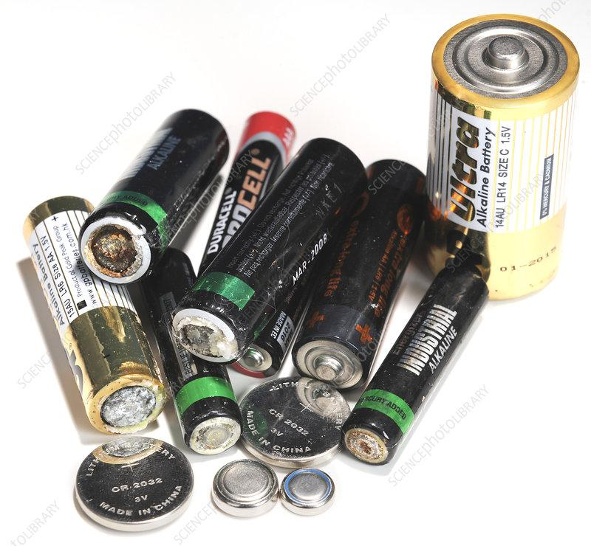

Batteries Should Not Be Placed In The Recycling Bin Or Thrown In The Trash Can
S11
Old batteries can explode, leak, release harmful gases or catch fire.
Notes:
Image Credit:
Batteries Picture: https://www.sciencephoto.com/media/640883/view/old-batteries
No Batteries: https://dpw.lacounty.gov/epd/hhw/Batteries

Slide 12
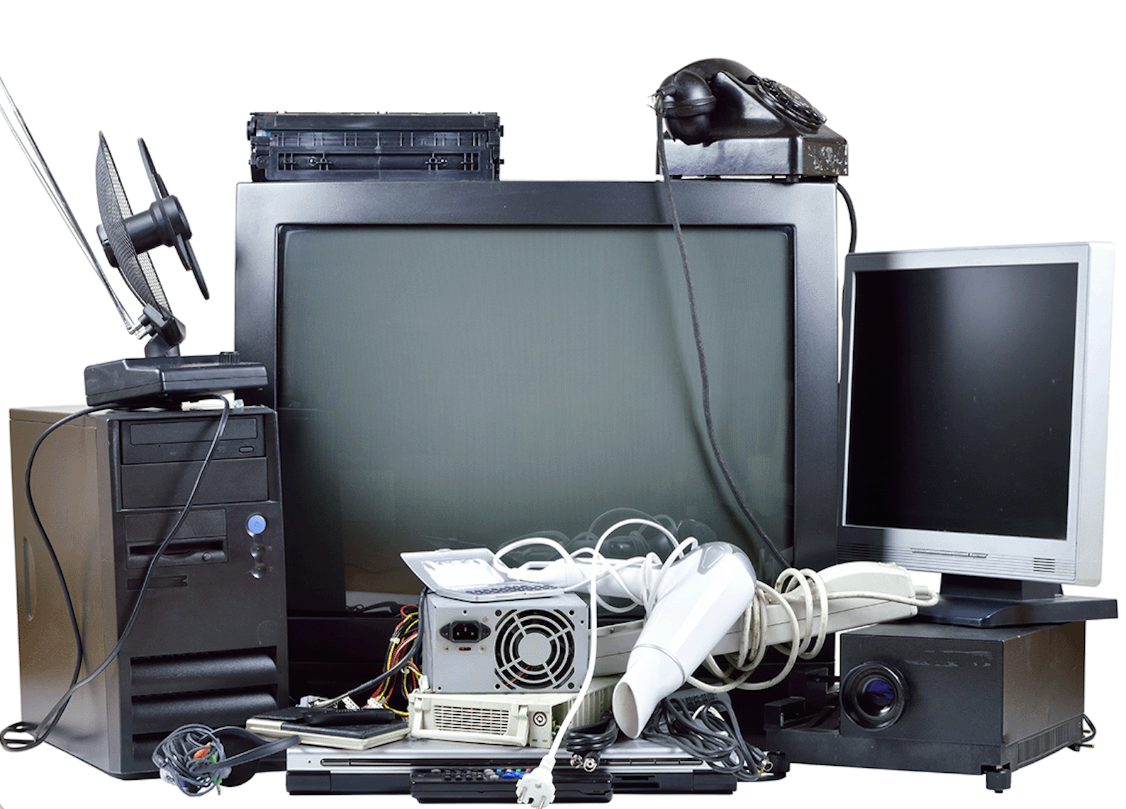
Electronic Waste or E-Waste
S12
Electronic waste or E-Waste is made up of consumer electronic equipment that is no longer wanted. E-Waste can include computers, printers, televisions, printers, VCR’s, cell phones, fax machines, stereos, electronic games, etc.
Do you have any E-Waste at your home? If so, what is it?
Is it still usable for others? If so, would you consider donating it to charity?
Notes:
Image credit: https://dpw.lacounty.gov/epd/cleanla/HHW.aspx

Slide 13


Electronic Waste or E-Waste should not be thrown in the trash.
S13
E-Waste may contain lead, copper, and other heavy metals or potentially toxic substances that are bad for the environment.

Slide 14

Collection Centers and Special Events
S14
Waste disposal is easy with Collection Centers and special events!
Click video to play.
YouTube Link: https://www.youtube.com/watch?v=9ycO-BjI_1k&t=2s

Slide 15

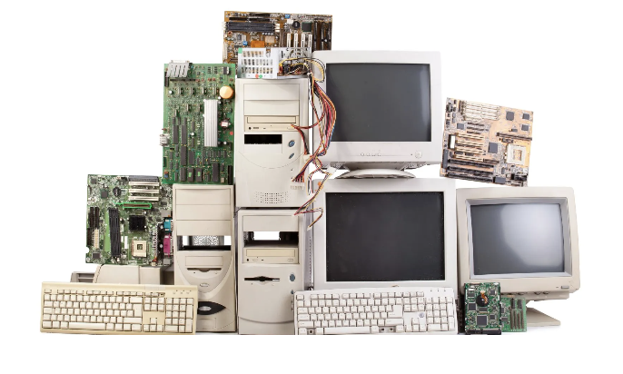
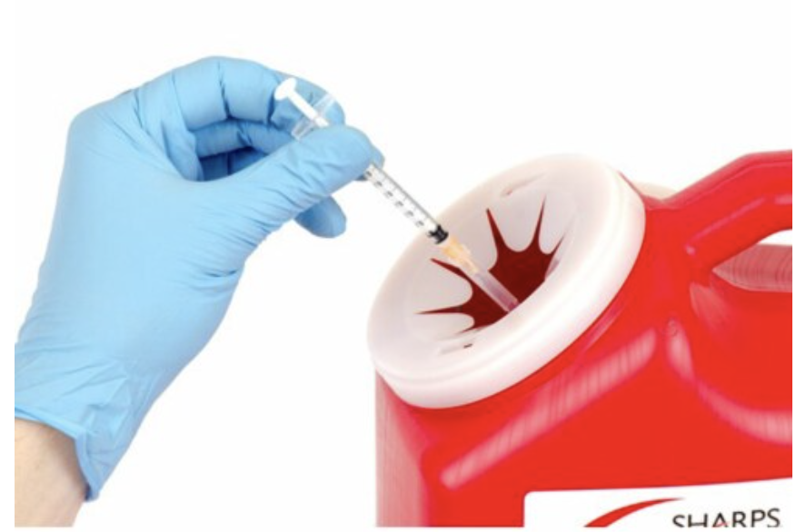
Student Explain: What have you learned?
S15
Using the information learned today, explain to a partner how each item should be properly disposed of.
  Leftover cleaning products
  Leftover paint
  Used motor oil
  Electronics
  Batteries
  Sharps
  Pharmaceuticals
WHERE SHOULD THESE ITEMS BE TAKEN? WHY?
Notes:
Image Credits:
Motor Oil: https://pngtree.com/freepng/color-shading-motor-oil-design-diagram-icon_3854889.html
Electronics: https://www.ecycleatlanta.com/free-electronics-recycling-atlanta

Slide 16
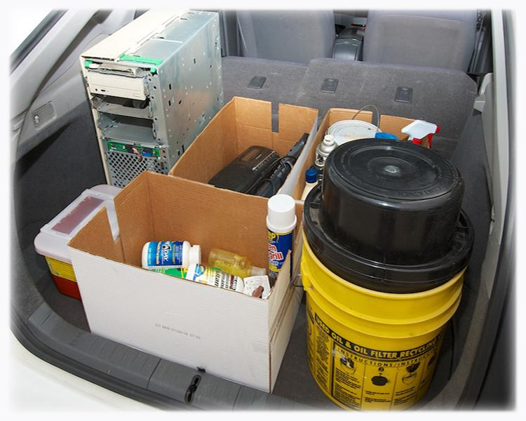
Student Explain: What do the Collection Centers or Events below do? Can You Find One Near You?
S16
Permanent Centers
Temporary Events
Household Hazardous Waste (HHW) Disposal
Electronic Waste (E-Waste) Disposal
Household Battery Disposal
Paint Recycling
Pharmaceutical Disposal
Sharps Disposal
Used Motor Oil Collection Centers
Notes:
Click on the links so that students can explore the various collection centers and events near them. Students will learn that many of the waste items reviewed today can be taken to permanent centers or temporary events.
Image credit: https://dpw.lacounty.gov/epd/hhw/Hhw

Slide 17
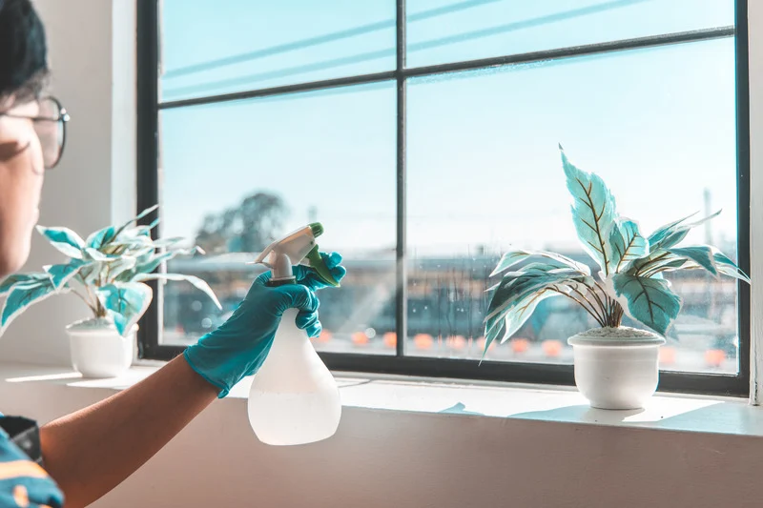
Student Extend: Let’s make an alternative household cleaning product for Windows!
S17
To make this alternative window cleaner,
you and your partner will need:
Juice from one lemon
2 cups water or club soda
1 teaspoon cornstarch
Mix all ingredients and pour evenly into two plastic spray bottles for each of you. Shake well. Spray solution onto window. Scrub and wipe with a newspaper.
Disclaimer: Results may vary. Test recipe effectiveness by applying a small amount of product to an area before using.
Notes:
This recipe and other alternative recipes for common household products can be found here:
https://cleanla.lacounty.gov/hhw/

Slide 18
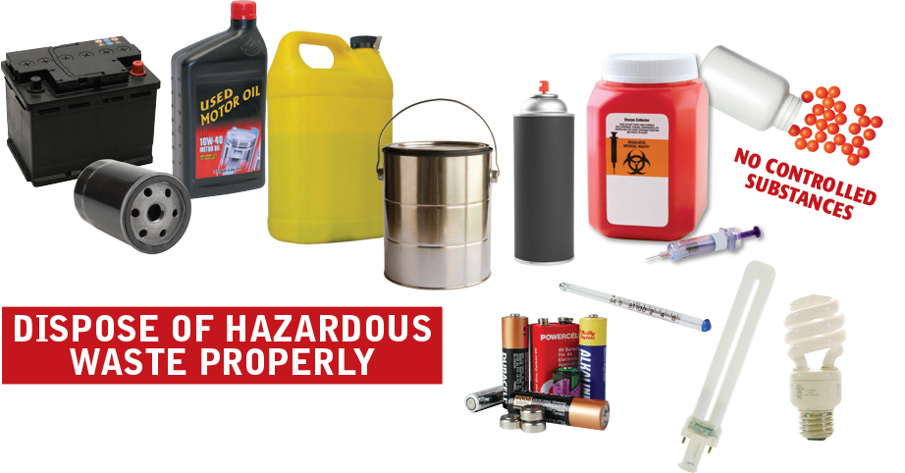
Student Elaborate: Come up with a poster to educate your family about household hazardous waste and E-Waste. Include the other items you learned about today.
S18
Who: Who will be your audience? Who can help you dispose of HHW, E-Waste and other hazardous items?
What: What types of substances/objects can be collect to be disposed of properly?
When: When can these items be disposed of?
Where: Where should you take these items be collected?
How: How can your family ensure that these types of waste do not end up in the garbage, down any drain, or in the ground?
Notes:
Materials Needed: Poster Paper or Tagboard, Markers / Writing Materials
Photo credit: https://naparecycling.com/residents/hhw-facility/

