Slide 1
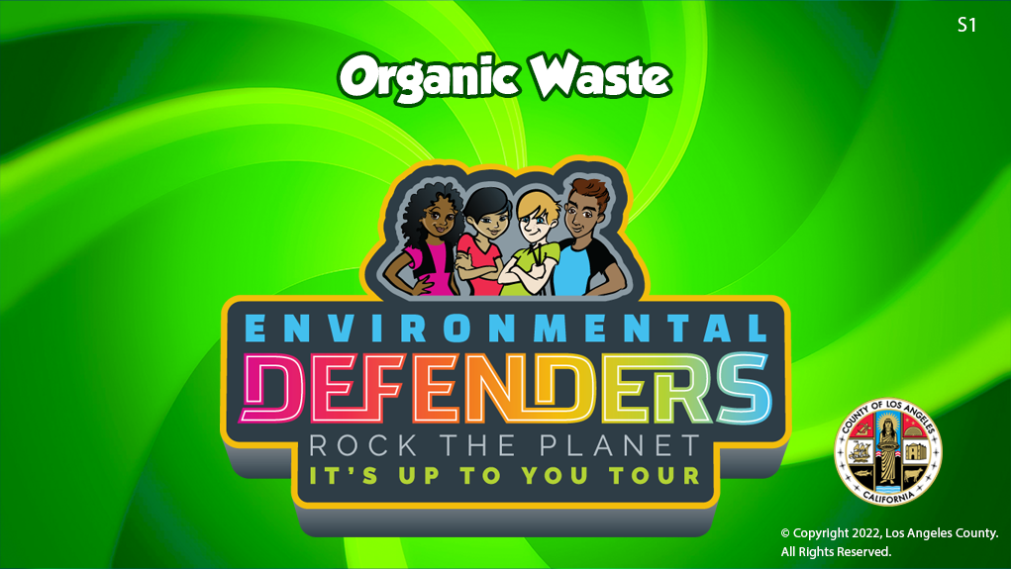

Slide 2

Essential Questions:
-How does reducing organic waste in landfills help our environment?
-What are some things you can do to help reduce organic waste in landfills?

Slide 3

Introduction – Engage / Explore
Let’s Explore Different
Types of
Organic Waste

Slide 4
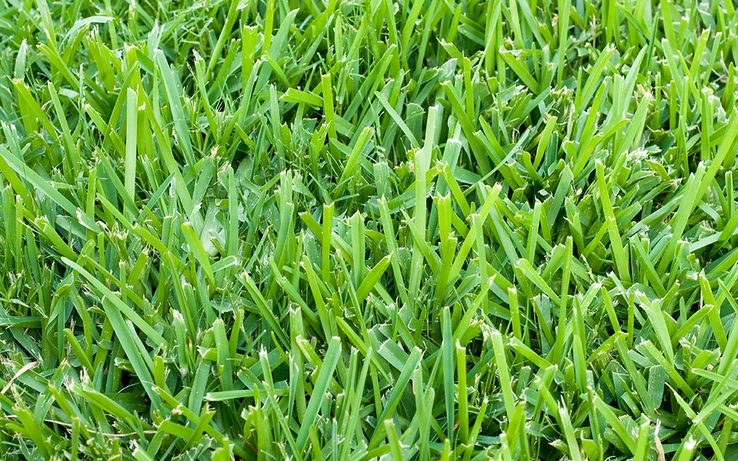
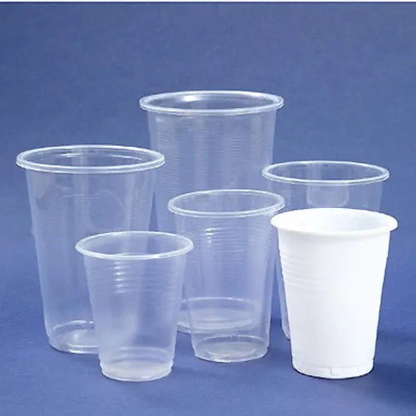
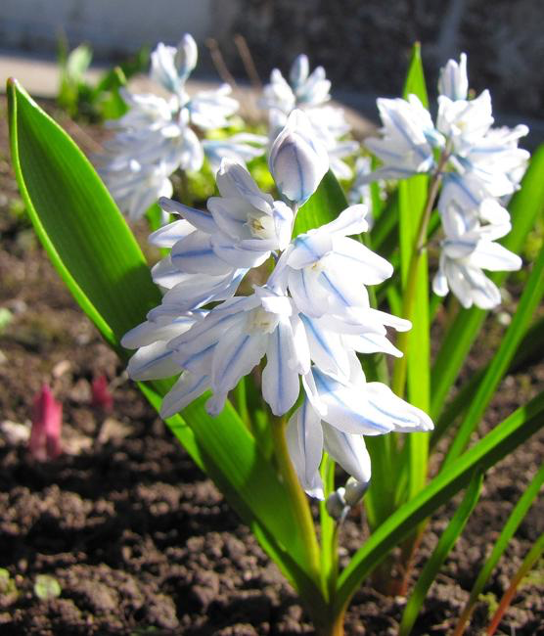

Which one of these pictures is not like the others? Explain why. How are the others alike?
A
B
C
D
Notes:
Green Waste
Photo Credits:
Grass: https://www.homedepot.com/c/ab/types-of-grass/9ba683603be9fa5395fab9048ce7861
Leaves: https://rhythmsofplay.com/collect-press-and-preserve-fall-leaves/
Flowers: https://www.lushome.com/colorful-spring-flowers-yard-landscaping-ideas/152520
Plastic Cups: https://www.indiamart.com/proddetail/pp-disposable-plastic-cups-22704295230.html

Slide 5
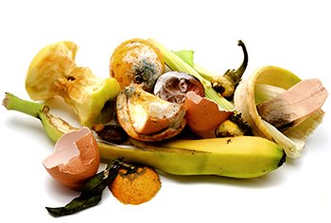
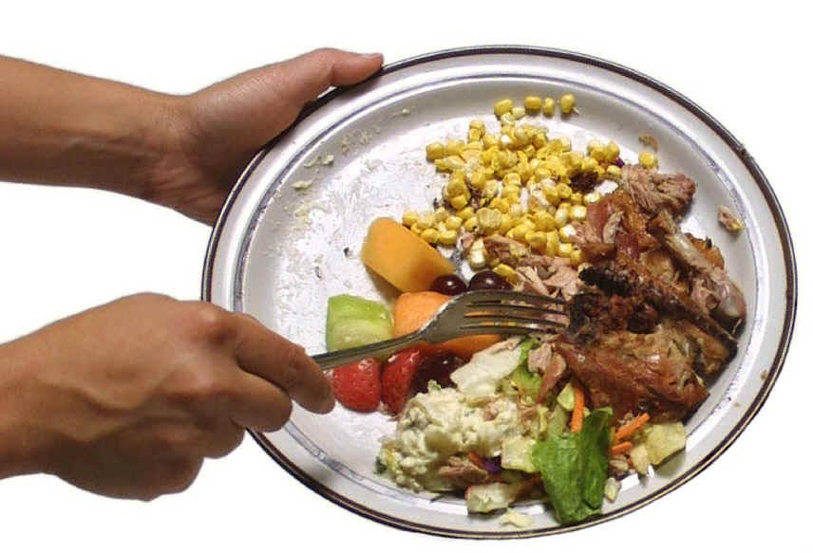
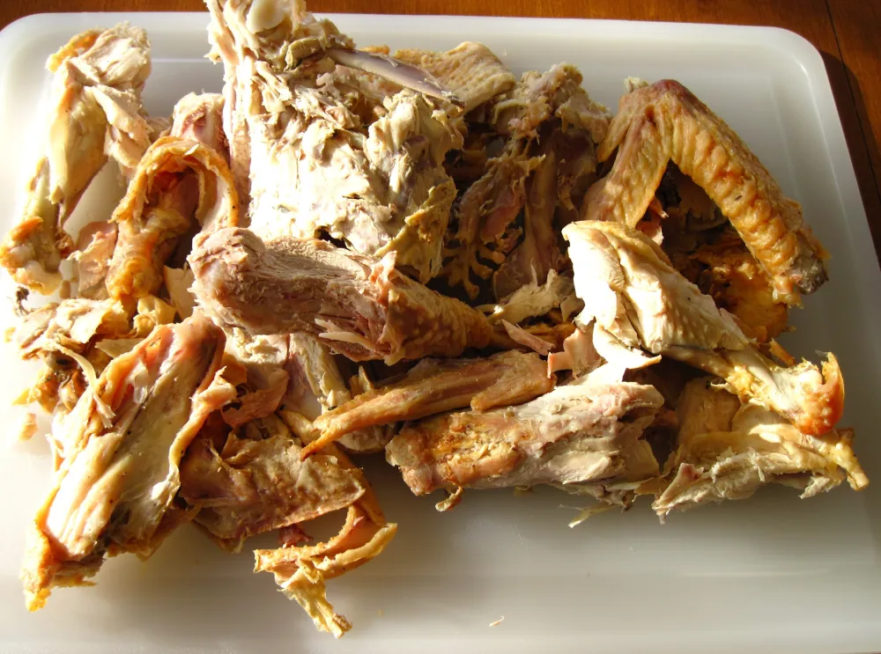
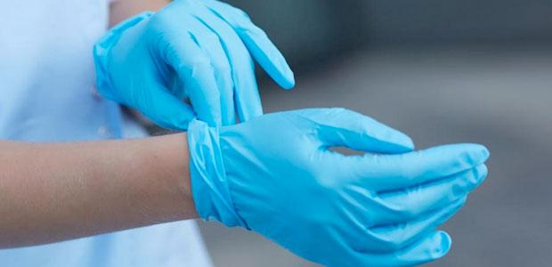
Which one of these pictures is not like the others? Explain why. How are the others alike?
A
B
C
D
Notes:
Food Scraps
Photo. Credits:
Food scraps upper left hand corner: https://www.cambridgema.gov/Departments/publicworks/news/2018/10/curbsidecompostinganniversary
Plate with hand and fork: https://www.huffpost.com/entry/food-waste-what-is-the-en_n_485846
Turkey meat and bones: https://center-of-the-plate.com/2016/11/26/save-the-turkey-bones/
Gloves: https://ohsonline.com/Articles/2010/04/01/Nine-Myths-About-Disposable-Safety-Gloves.aspx

Slide 6
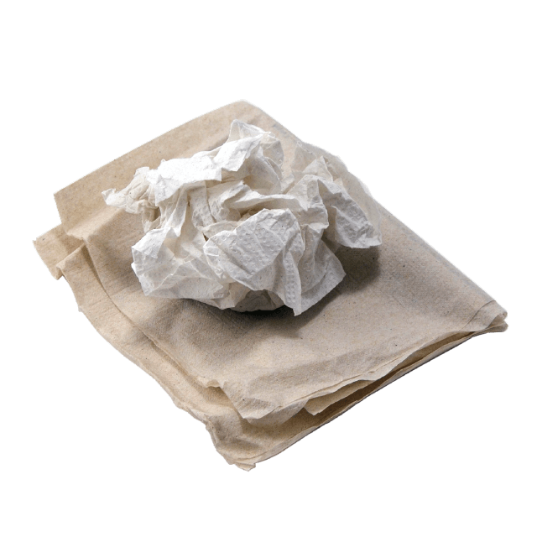
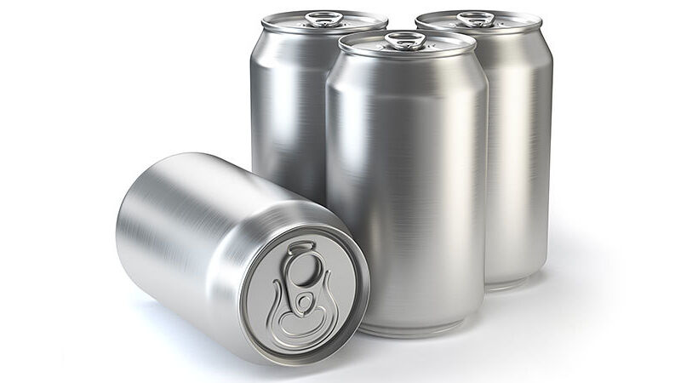
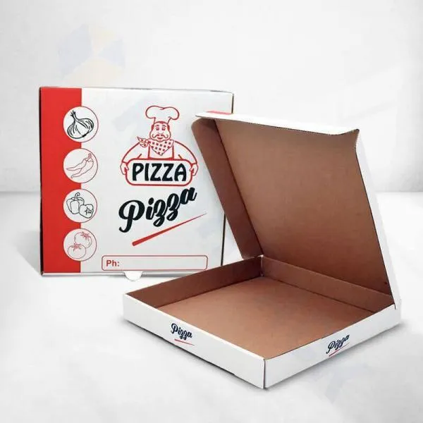
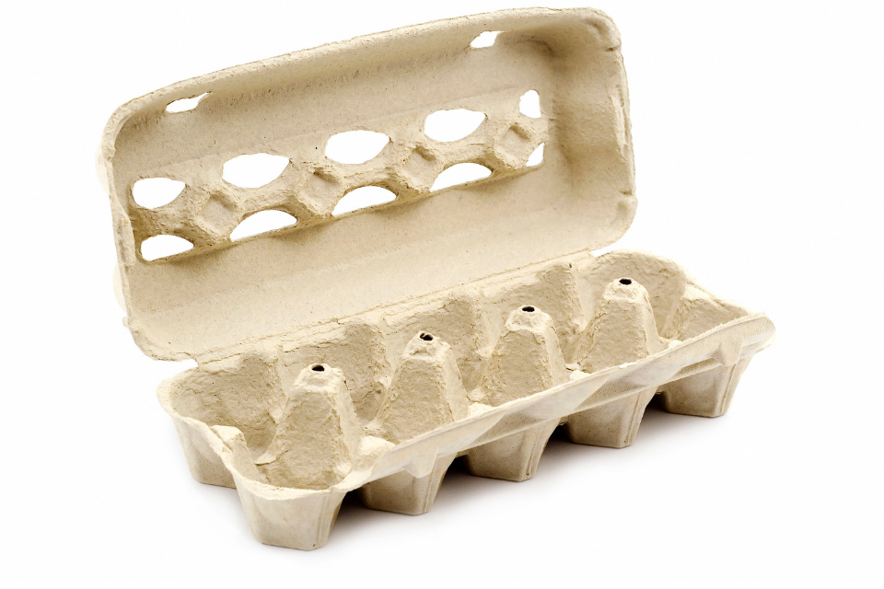
Which one of these pictures is not like the others? Explain why. How are the others alike?
A
B
C
D
Notes:
Food Soiled Paper - Must be 100% fiber-based. No materials with petroleum based plastic, wax, or bio-plastic coating, liner or laminate
Photo Credits:
Egg Carton: https://www.keeptruckeegreen.org/recyclable/egg-cartons-paper/
Pizza Box: https://aaradhyabox.in/pizza-boxes/
Paper towel and napkin: https://www.piercecountywa.gov/5189/Why-Cant-I-Recycle
Aluminum Cans: https://aluminiumtoday.com/news/can-recycling-at-74

Slide 7
The three general categories of organic waste:
-Food Scraps
-Food Soiled Paper
-Green Waste
*At the beginning of the lesson you listed things you recycle at home or school. Were any of them organic waste?

Slide 8

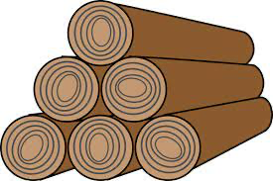

Student Explain: The items listed below are also considered organic waste. Which category of organic waste can we add each item to? Why?
Branches
Bread, rice, pasta
Paper plates
Lumber, scrap wood and unpainted/untreated plywood
Coffee grounds
Paper to-go boxes (no coating)
Weeds
Seafood & Soft Shells
Pet Food (non-medicated)
Cheese and dairy

Slide 9

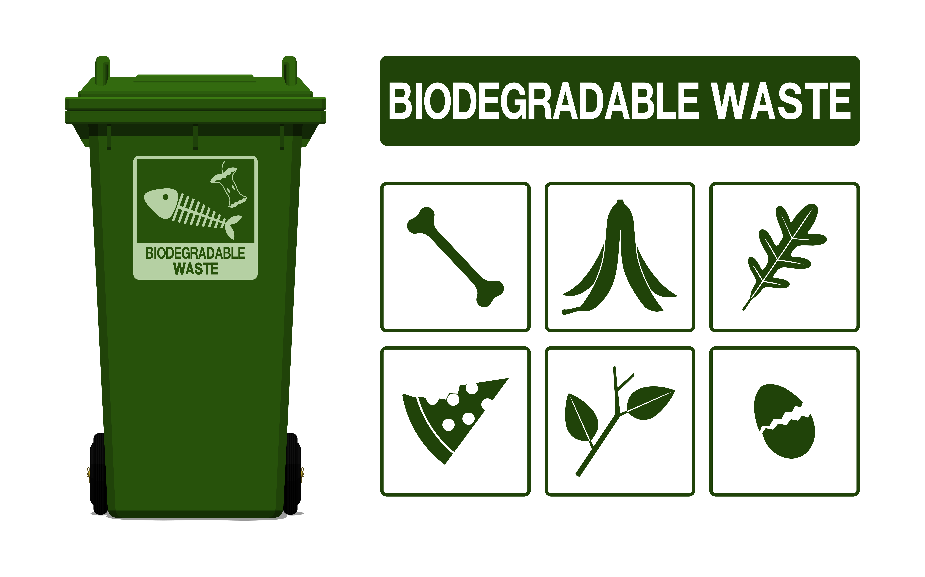
Academic/Scientific Vocabulary
Organic Waste: Any material that is biodegradable and comes either from a plant or an animal.
Biodegradable Waste: Organic material that can be broken into carbon dioxide, methane or simple organic molecules.
Notes:
Image credits:
https://www.dreamstime.com/examples-biodegradable-waste-garbage-compost-examples-biodegradable-waste-garbage-compost-flat-vector-illustration-image168663798
https://www.dreamstime.com/set-biodegradable-waste-icon-transparent-background-set-biodegradable-waste-icon-transparent-background-image197545726

Slide 10
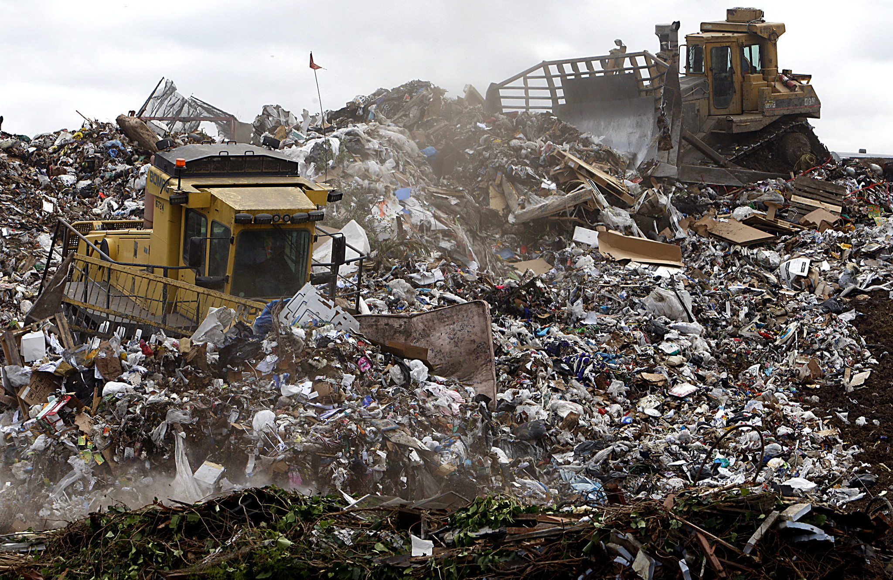
This is a picture of a landfill. Describe what you see. How did all this trash get here?
Notes:
Heavy equipment operators use machinery to compact and shape mountains of trash at L.A. County’s Puente Hills Landfill. (Luis Sinco / Los Angeles Times)
http://www.latimes.com/world/global-development/la-fg-global-trash-20160422-20160421-snap-htmlstory.html

Slide 11
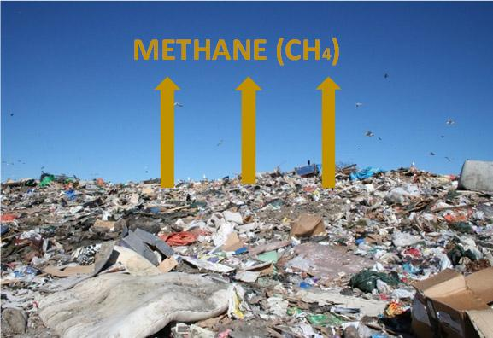
Teacher Explain: What happens to Organic Waste in Landfills?
When organic waste is dumped in landfills, it undergoes anaerobic decomposition (due to the lack of oxygen) and produces methane.
Notes:
Photo Source:
http://www.omegaenergy.com.au/waste-streams/waste-trends/
“Methane released from Landfills has 21 times the Greenhouse impact as the same amount of CO2!”

Slide 12
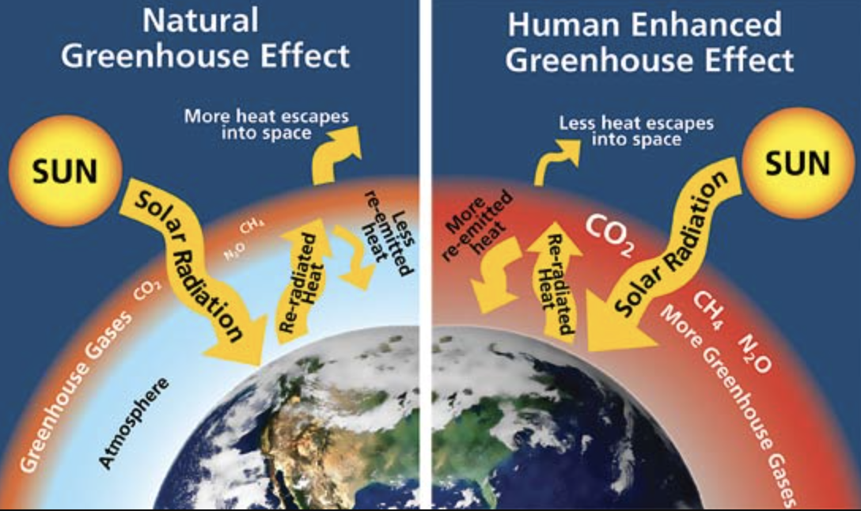
Teacher Explain: Why is methane gas harmful to our environment?
When released into the atmosphere, methane is 20 times more potent as greenhouse gas than carbon dioxide. Organics recycling reduces greenhouse emissions.
Notes:
Photo Credit
https://climatechange.lta.org/get-started/learn/co2-methane-greenhouse-effect/
“Greater concentrations of greenhouse gases mean more solar radiation is trapped within the Earth’s atmosphere, making temperatures rise. Source: W. Elder, NPS.”

Slide 13
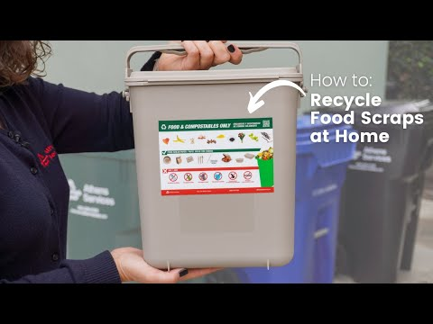
Teacher Explain: How do we properly dispose of organic waste so it does not end up in our landfills and cause methane gas?
  Recycling Organic Waste at Home
Video link: https://www.youtube.com/watch?v=qcKpO1pKVq0

Slide 14
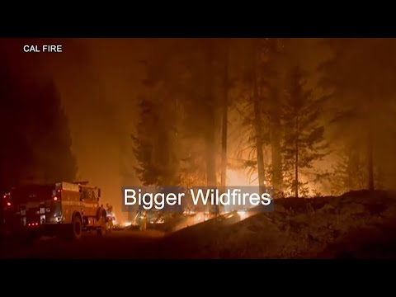
Learn About Senate Bill 1383
Student Elaborate: How does Senate Bill 1383 help reduce organic waste in landfills?
Video Link: https://www.youtube.com/watch?v=7ZoiQVyIW3M

Slide 15

Student Elaborate: Make an action plan poster to educate others about collecting organic waste.
Who: Who will be your audience? Who can collect organic waste?
What: What types of items can be collect as organic waste?
Where: Where should organic waste be collected and recycled?
How: How can they ensure that organic waste does not end up in landfills?
Notes:
Student Resources to use while developing their action plan:
Appendix A: SB 1383 Climate Pollutant Reduction Law
Appendix B: Recycling and Organics: Recycling Guide for Schools
- Poster Paper or Tagboard
- Markers / Writing Materials
Photo credit:
https://www.gregsavage.com.au/2020/03/26/free-recruiter-business-action-plan-in-time-of-crisis/

Slide 16
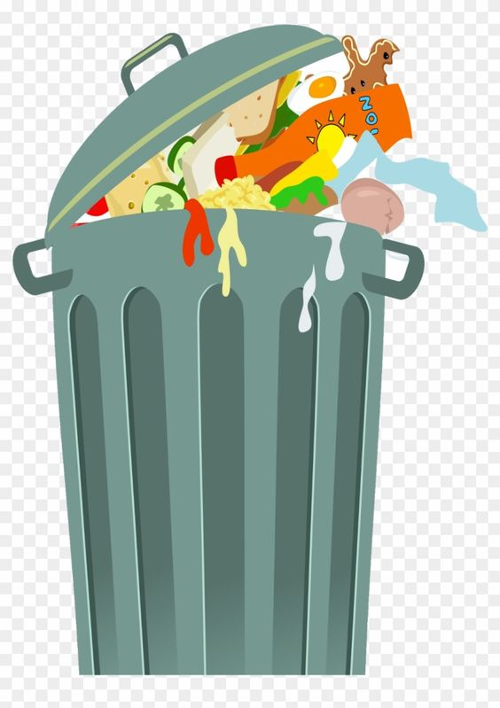
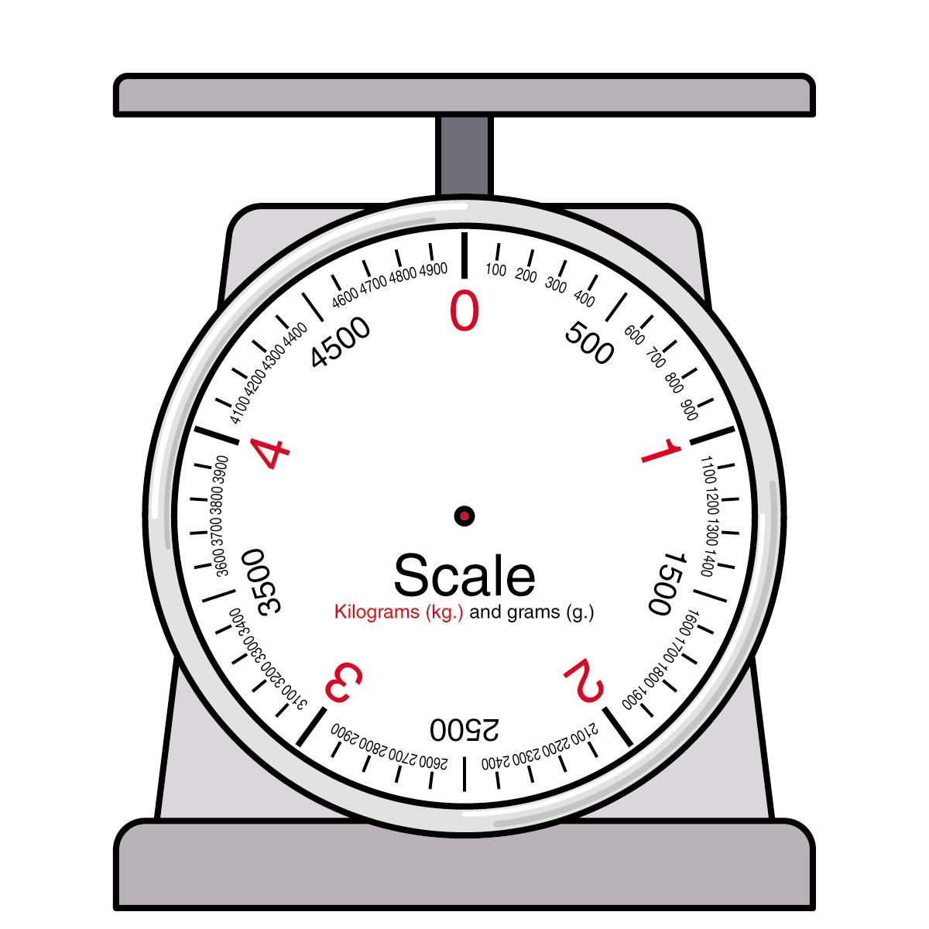
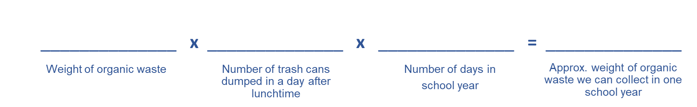
Student Extend: How much organic waste can our school collect in one school year?
What you’ll need:
  1 trashcan full of lunch time waste
  Non latex Gloves
  Goggles
  Weight Scale
  Directions: Put on non latex gloves and goggles. Separate the inorganic waste from the organic waste. In your journal list all the inorganic and organic waste collected. Weigh the organic waste and use it to solve the math problem below.
  *What are the equivalent emissions that will be decreased by your school by not sending organic waste to the landfill for one school year? Natur-Bag Food Scrap Calculator
Notes:
Photo credit
http://clipart-library.com/clipart/1820750.htm
https://www.pinterest.com/pin/777645060650418677/

