Slide 1
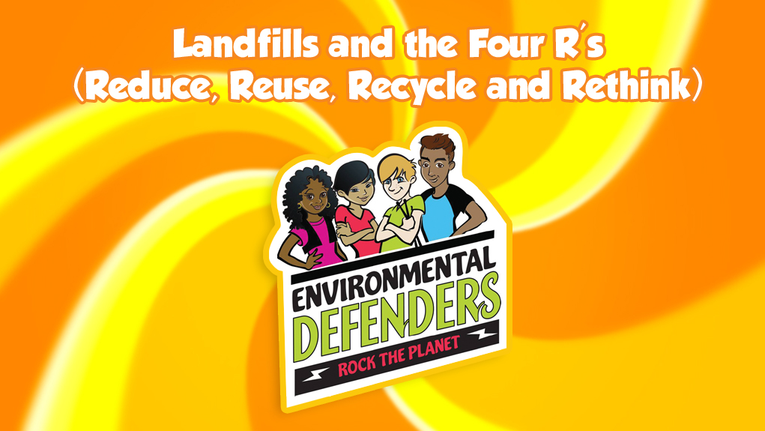

S1
© Copyright 2018, Los Angeles County.
All Rights Reserved.

Slide 2
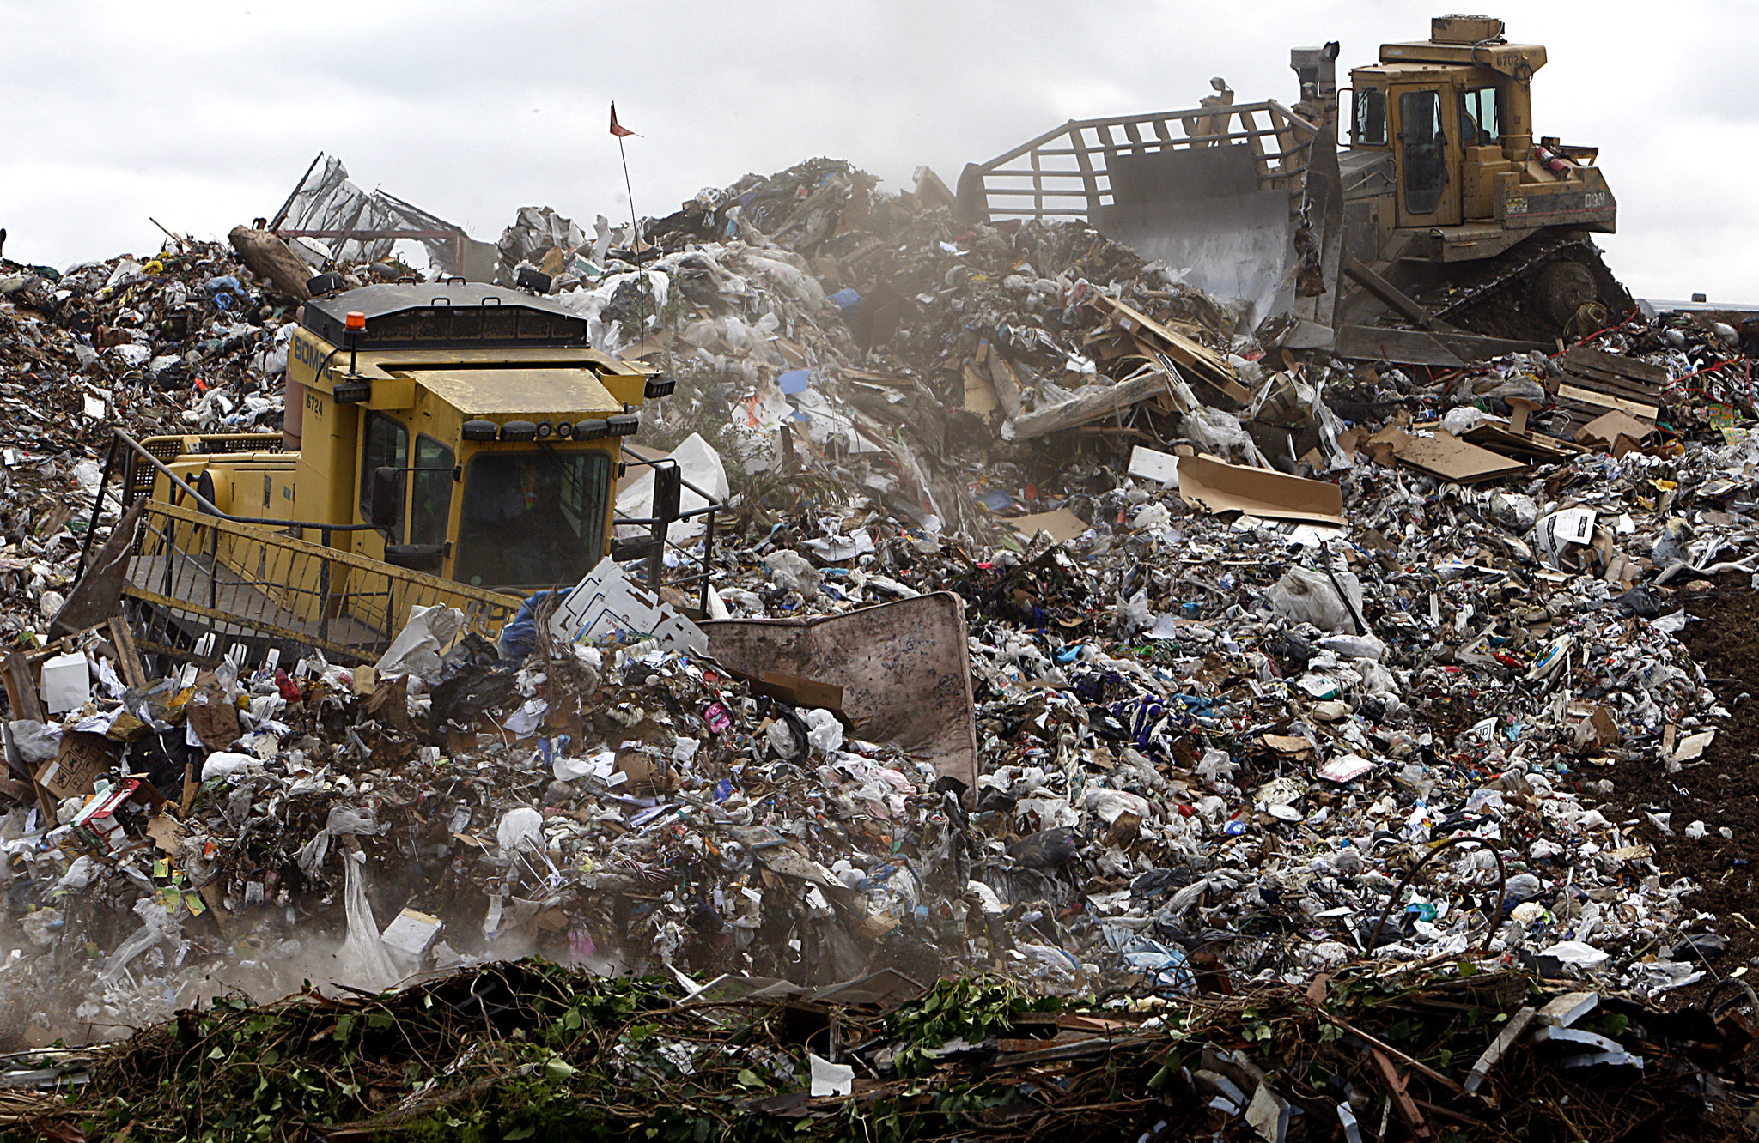
Take a look at the picture below.
What do you see?
What questions do you have?
S2
http://www.latimes.com/world/global-development/la-fg-global-trash-20160422-20160421-snap-htmlstory.html

Slide 3
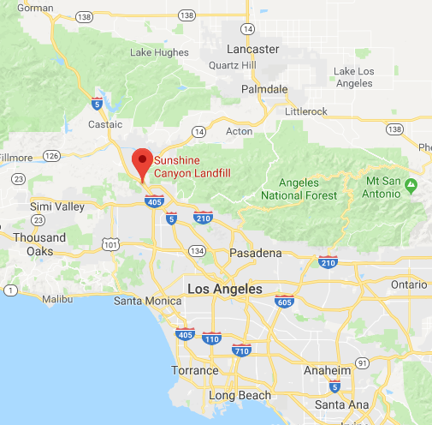
Our waste ends up in landfills. How close is the
Sunshine Canyon Landfill to where you live?
S3

Slide 4
Where does all the waste come from?
How does it get to the landfill?
S4

Slide 5
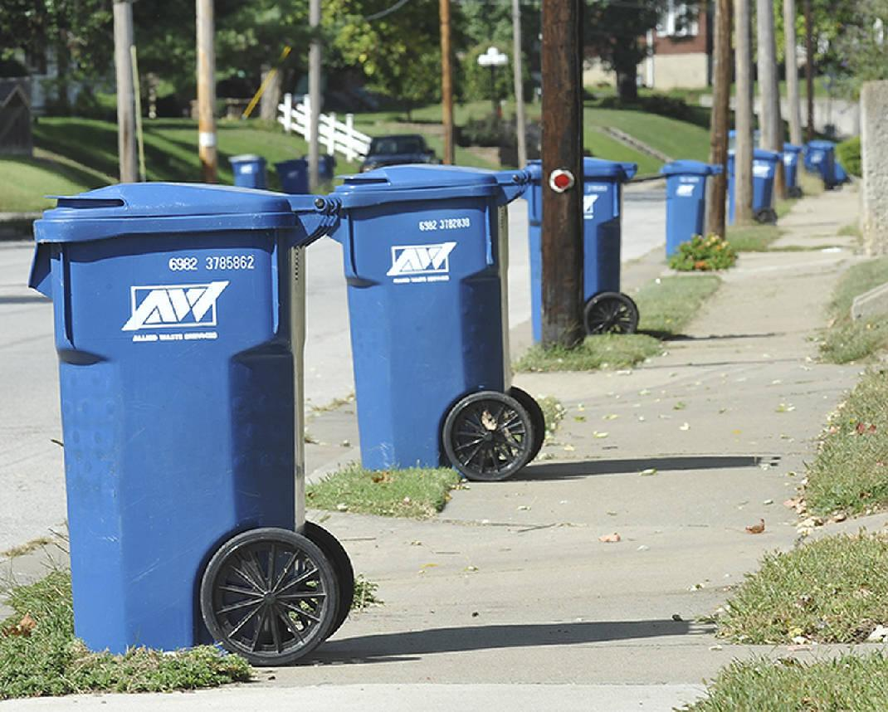
S5
http://www.newstribune.com/news/news/story/2015/jan/23/businesses-seek-open-market-trash-services/501050/

Slide 6
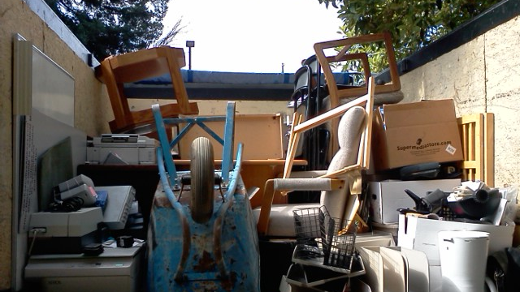
S6
http://www.inlandempirejunkremoval.net/make-home-free-garbage-hiring-junk-free-service/

Slide 7
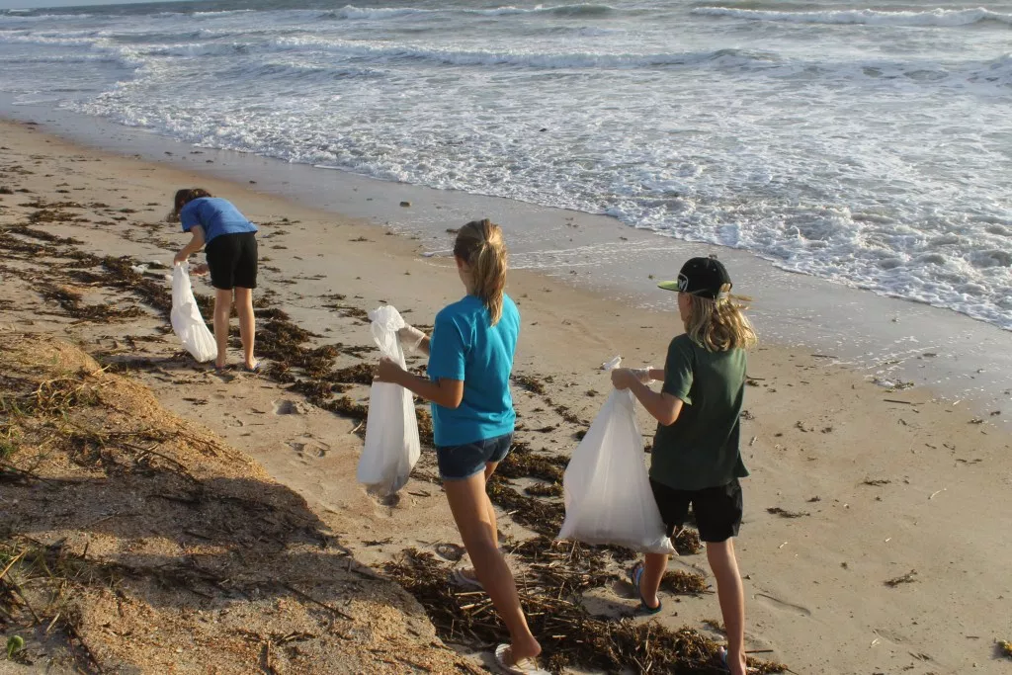
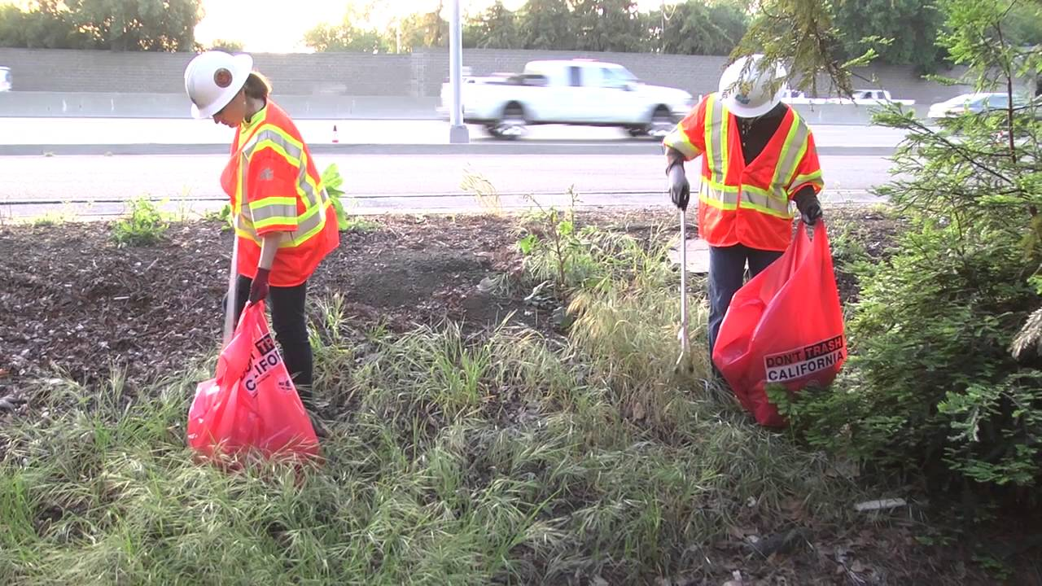
S7
http://yourcoastnews.com/grover-beach/34th-annual-california-coastal-cleanup-day/
https://www.youtube.com/watch?v=gJJHAIxulGQ

Slide 8
What are the different types of waste that end up in our landfill?
S8

Slide 9
Sort the cards into two categories.
Why did you group them together the way you did?
S9

Slide 10
What do these items have in common?
Tree Trunk
Cut Grass
Old Magazines
Banana Peel
Old Leather Jacket
Cardboard
Spoiled Food
S10

Slide 11
Organic:
1) of, relating to, or derived from living organisms;
2) of, relating to, or containing carbon compounds
S11
Notes:
https://www.merriam-webster.com/dictionary/organic

Slide 12
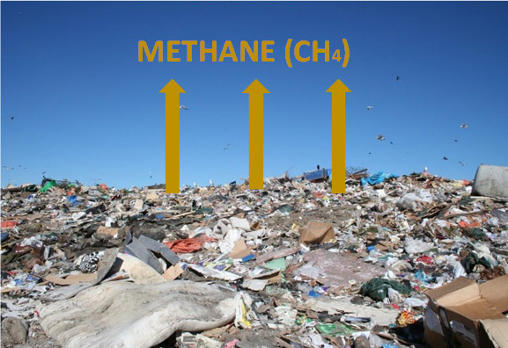
S12
http://www.omegaenergy.com.au/waste-streams/waste-trends/

Slide 13
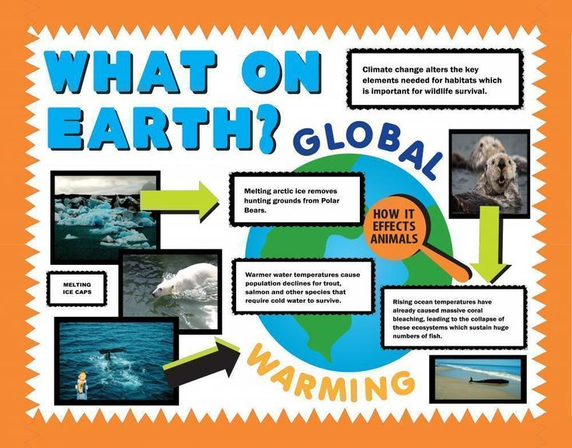
S13
http://www.artskills.com/gallery/poster-categories/science-health/what-on-earth

Slide 14
What do these items have in common?
Plastic Bottle
Glass
Aluminum Can
Car tire
Polystyrene Foam Cup
Toothbrush
Soup Can
S14

Slide 15
Inorganic:
1) being or composed of matter other than plant or animal;
2) not arising from natural growth
S15
Notes:
https://www.merriam-webster.com/dictionary/inorganic

Slide 16
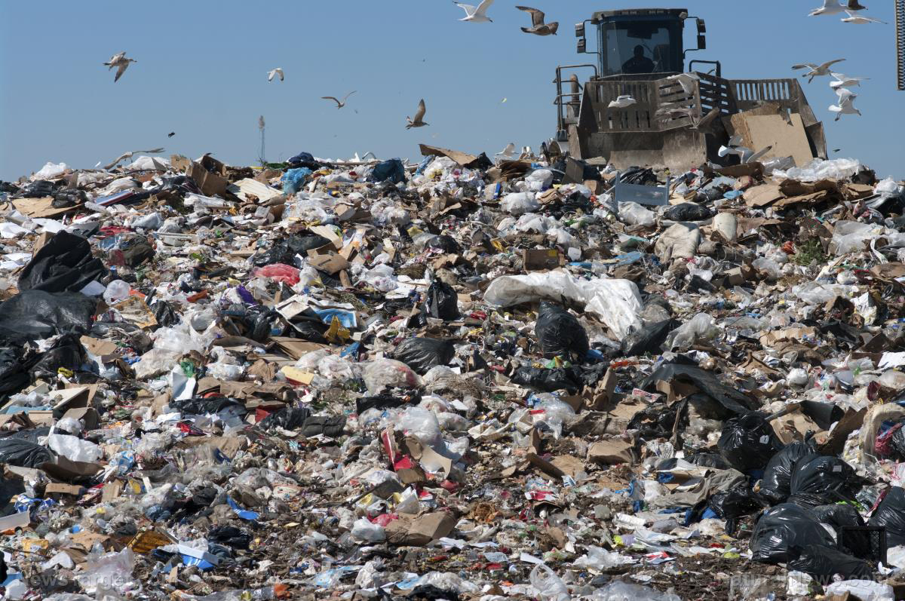
How long will waste stay in our landfills?
S16
http://www.naturalnews.com/2017-05-01-the-end-of-plastic-landfill-researchers-discover-caterpillar-that-eats-plastic-its-called-a-wax-worm.html

Slide 17
“Decomposition is the process of decaying or rotting. If you ever left a carved pumpkin on the porch into late November, you have seen and smelled decomposition.”
S17
Notes:
https://www.vocabulary.com/dictionary/decomposition

Slide 18
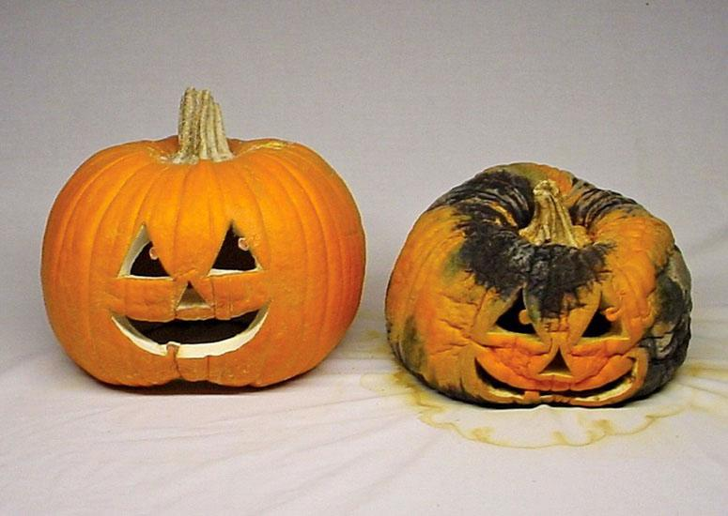
S18
https://www.thegreenhead.com/2011/09/dr-frybrains-pumpkin-embalmer.php

Slide 19
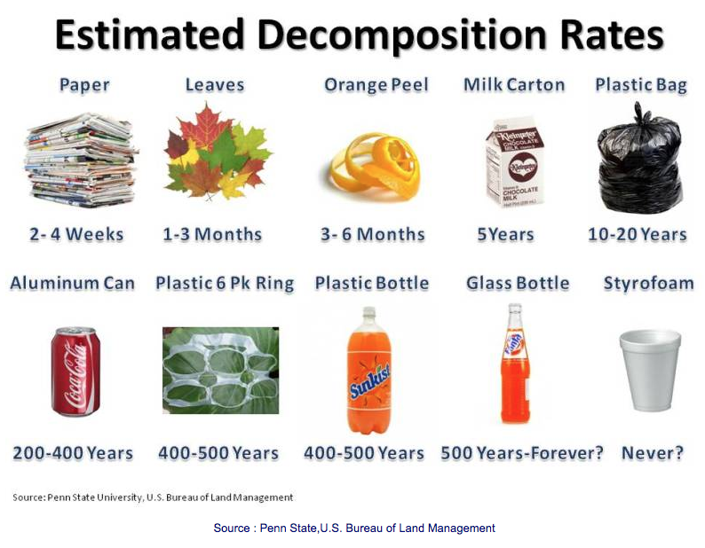
S19
http://www.earthlyissues.com/recycling.htm

Slide 20
How do we keep our landfills from filling up?
S20

Slide 21
Conservation: Anything we do to protect our planet to conserve its natural resources so that every living thing can have an improved quality of life.
S21
Notes:
Source: https://www.conserve-energy-future.com/methods-and-importance-of-environmental-conservation.php

Slide 22
What can you do to conserve and protect our planet so that less waste ends up in landfills?
S22

Slide 23
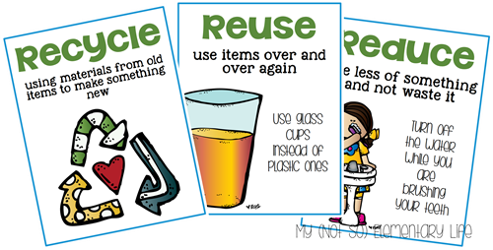
Reduce – Reuse – Recycle
S23
http://www.efoza.com/post_reduce-reuse-recycle-poster_262248/

Slide 24

The Fourth R – Rethink!
S24
http://www.bkmoe.com/services/recycling-and-storage/

Slide 25

Create a public service announcement for your community!
S25
https://psanycsquad.podbean.com/

