Slide 1


Slide 2
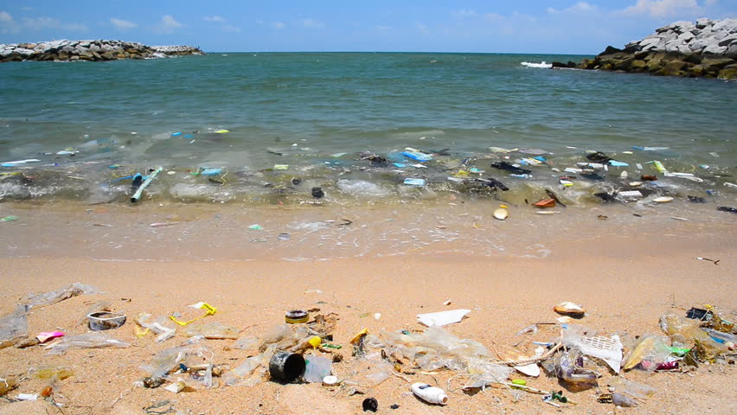
What is Wrong With This Picture?
https://www.shutterstock.com/video/clip-9500465-stock-footage-pollution-on-the-beach-of-tropical-sea.html?src=rel/13104191:1/gg

Slide 3
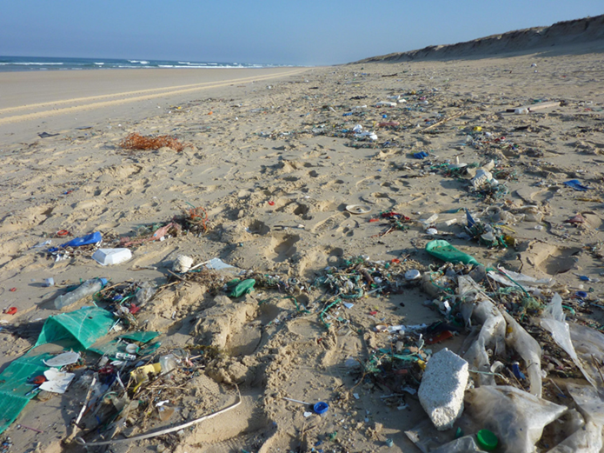
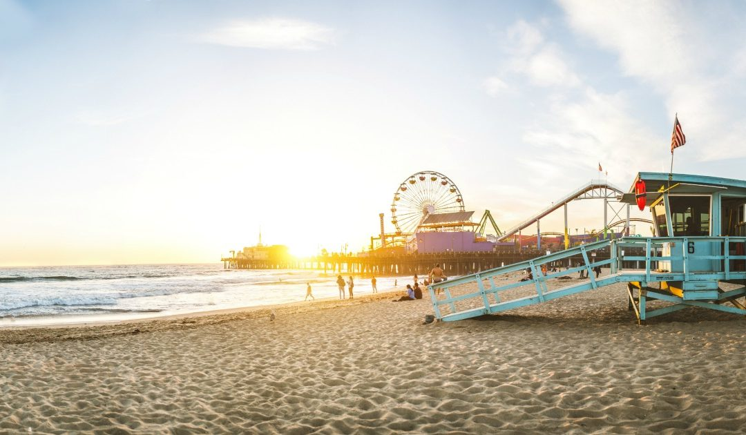
How Should a Beach Look?
https://supervisorkuehl.com/wp-content/uploads/2017/06/Heal-the-Bay-Report-Card-1080x630.jpg

Slide 4

Who Made All of This Waste and
How Do You Think it Ended Up at the Beach?
Chart student responses
Who?
How?

Slide 5
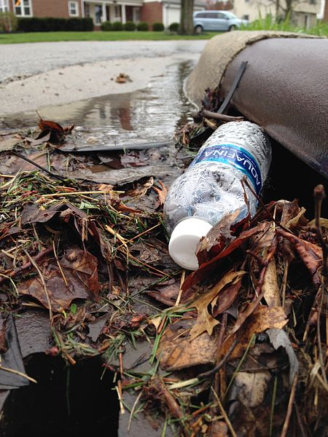
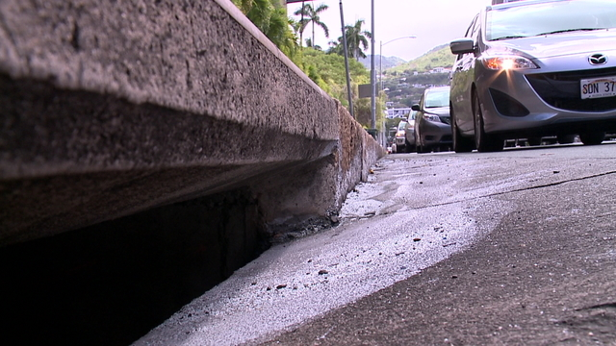
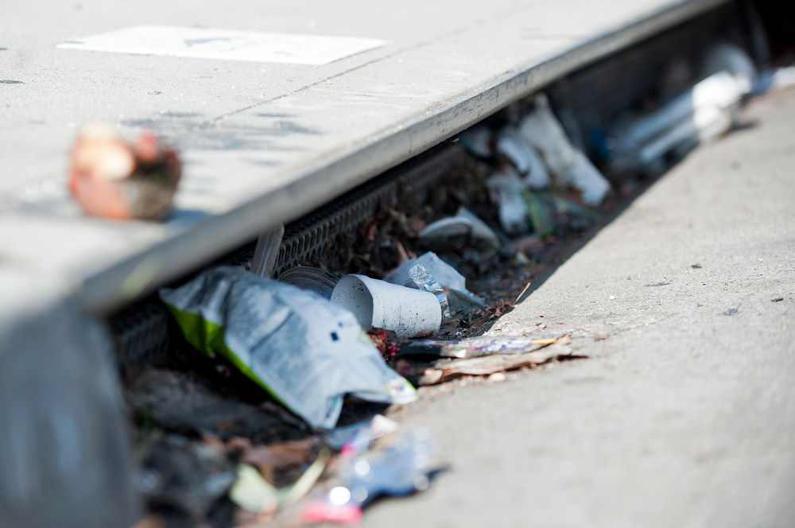
What are Pollutants?
Any substances that can hurt the environment.
What is Stormwater Pollution?
Excess water that runs down storm drains
carrying pollutants from the environment.
https://commons.wikimedia.org/wiki/File:%22I_prefer_the_bottled_stuff,%22_said_the_storm_drain._(25565964563).jpg
https://www.khon2.com/news/local-news/contractor-caught-dumping-waste-water-down-storm-drain/1025784152
https://www.scpr.org/news/2018/07/17/84816/l-a-county-voters-to-decide-on-new-stormwater-tax/

Slide 6
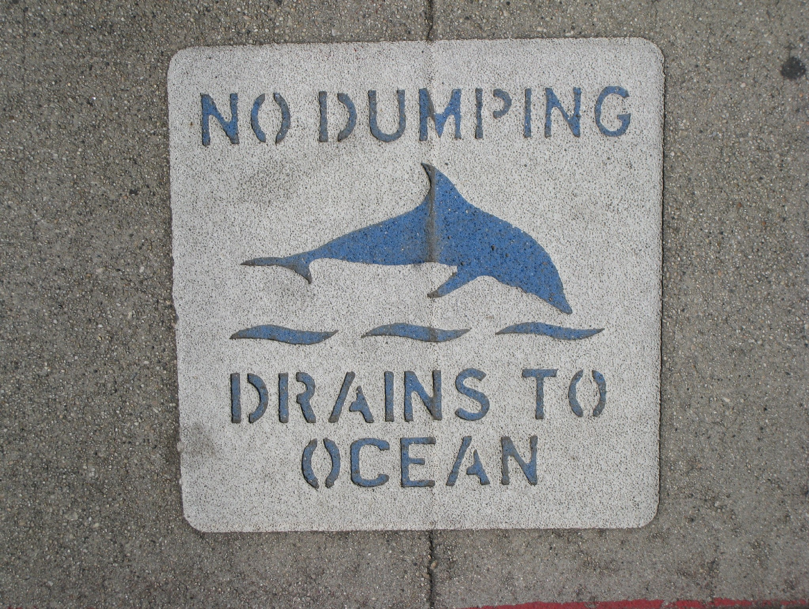
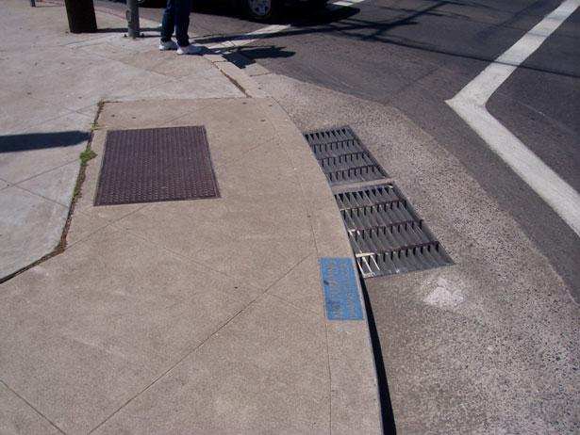
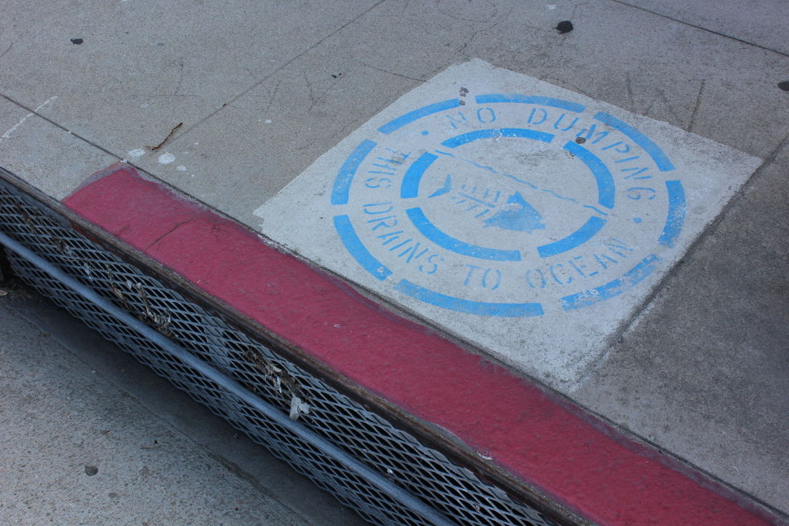
Have You Seen These?
http://www.watereducation.org/aquafornia-news/innovative-ideas-southern-california-practical-projects-and-techniques-show-how
http://www.kabbara.net/?page_id=468
http://tbrnews.com/news/hermosa_beach/hermosa-beach-calls-on-community-to-help-stencil-storm-drains/article_263b58c6-ef90-11e4-b87c-53412c3a2f3c.html

Slide 7
School Community Field Trip
We will take a field trip around our school.
Follow the directions in the map given to you.
Look for storm drain inlets (or catch basins) and mark them on your map with a blue checkmark.
Take note of any pollutants that can end up going down the storm drain inlets (or catch basins).
What do you think will happen to them?

Slide 8
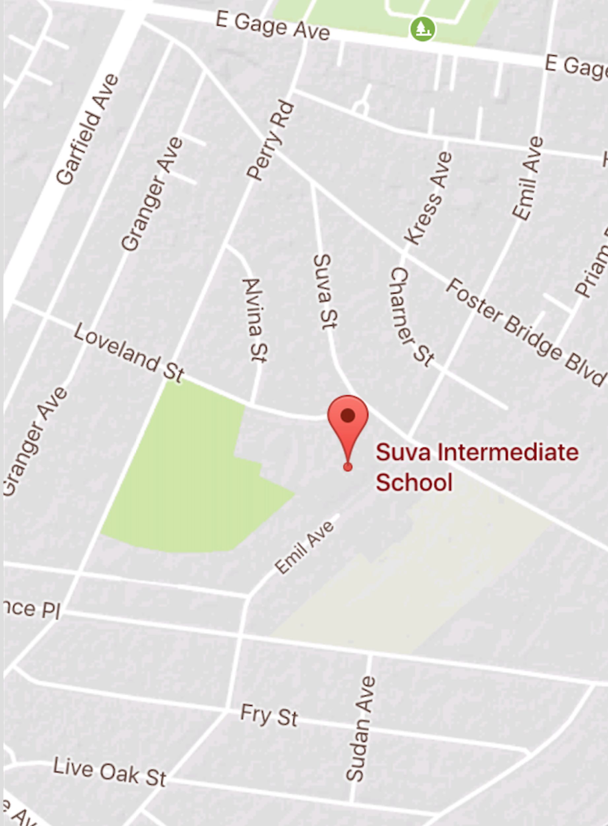





Field Trip Map
KEY
Route and
direction of field trip
Storm drain inlet (or catch basin) location
SAMPLE

Slide 9
Field Trip Discussion Questions
How many storm drain inlets (or catch basins) did we see?
What types of waste or pollutants did you notice on our streets?
What do you think will happen to all the waste we found?

Slide 10
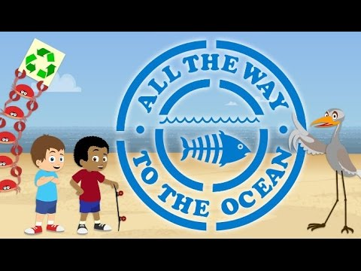
All the Way to the Ocean
Notes:
Youtube video link: https://www.youtube.com/watch?time_continue=5&v=sZW2ByM623g

Slide 11
Create an Informational Brochure or Booklet for Our Community:
“How to Prevent Stormwater Pollution”

Slide 12
Instructions: Work with your group to research the following questions. Be sure to include the information in your brochure or booklet:
A. What is stormwater pollution?
B. What are some sources of stormwater pollution?
C. What can people do to prevent stormwater pollution?

Slide 13
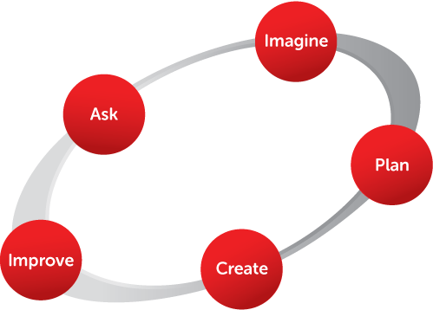
Engineering Design Process
ASK: What is the problem? How have others approached it? What are your constraints?
IMAGINE: What are some solutions? Brainstorm ideas and choose the best one.
PLAN: Draw a diagram or blueprint. Make lists of materials you will need.
CREATE: Follow your plan and create your prototype. Test it out!
IMPROVE: What works? What doesn't? What could work better? Modify your design to make it better. Test it out!
https://eie.org/overview/engineering-design-process
Notes:
https://eie.org/overview/engineering-design-process

Slide 14
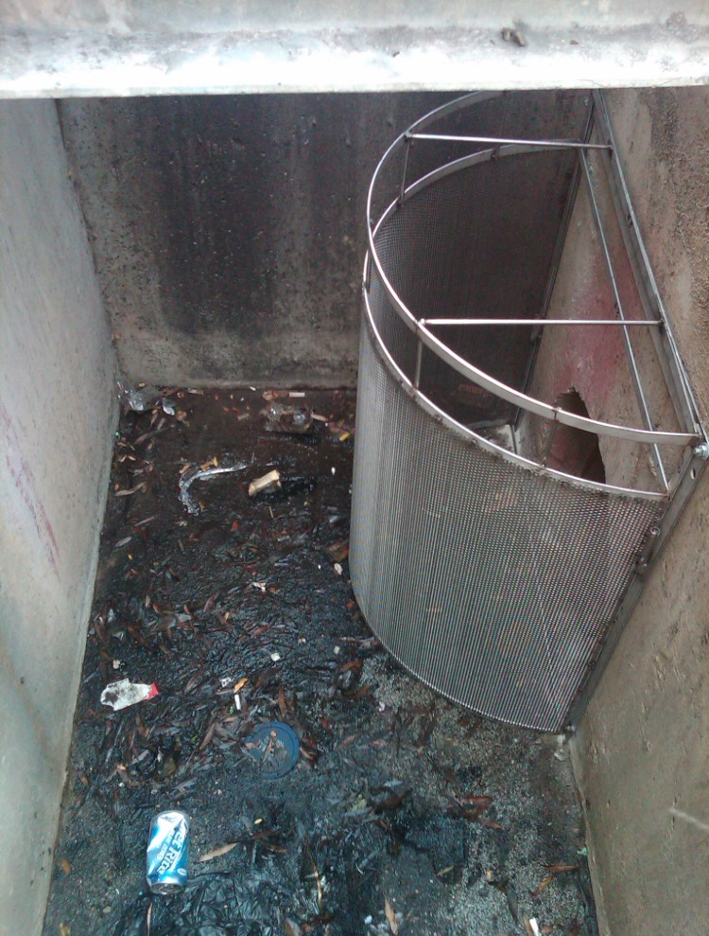
Background: LA County Public Works uses screens made out of fine mesh material to catch stormwater pollutants.
Problem: When waste covers the fine mesh, the stormwater overflows and goes to the ocean and beaches.
Can you design a better solution?
Photo Credit: Miguel Mendoza, Jr.

Slide 15
Constraints: Limitations to a design.
What are some constraints when using a mesh screen to filter out pollutants at this catch basin?
Photo Credit: Miguel Mendoza, Jr.

Slide 16
Imagine: Use creativity and ingenuity to develop a solution to filter out pollutants at catch basins.
Let your imagination run wild!
Brainstorm some ideas.
Pick the best one to plan further.

Slide 17
Plan: Now that you’ve chosen your best idea, draw a detailed diagram of a prototype, or blueprint, and describe the materials you would need to build it.
How does your solution prevent pollutants from going to the ocean? Where do they go instead? Brainstorm some ideas.
What types of materials did you use?
Present your design to the class!

Slide 18
Create: Following the design of your blueprint and using materials around your home, create a small prototype and test it.
How does it work?
What works best?
What doesn’t
What could work better?

Slide 19
Improve: Based on your initial test, modify your design to make it better. Test it out again!

