Slide 1
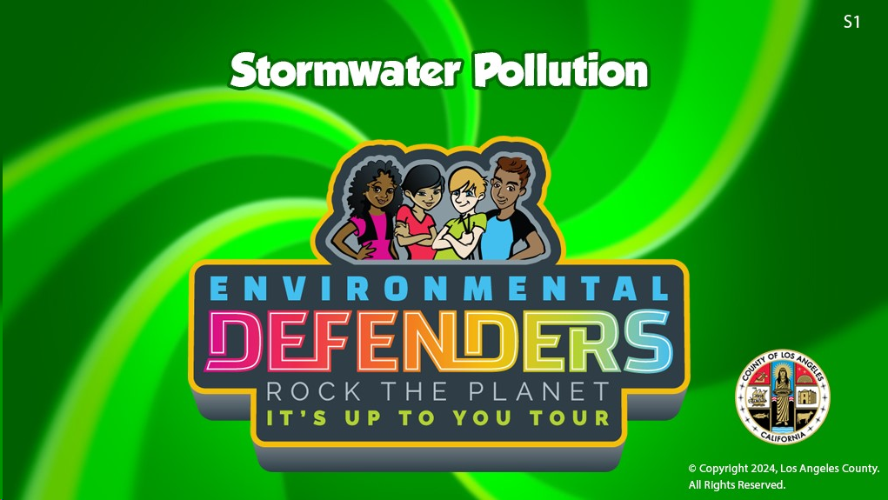

Slide 2
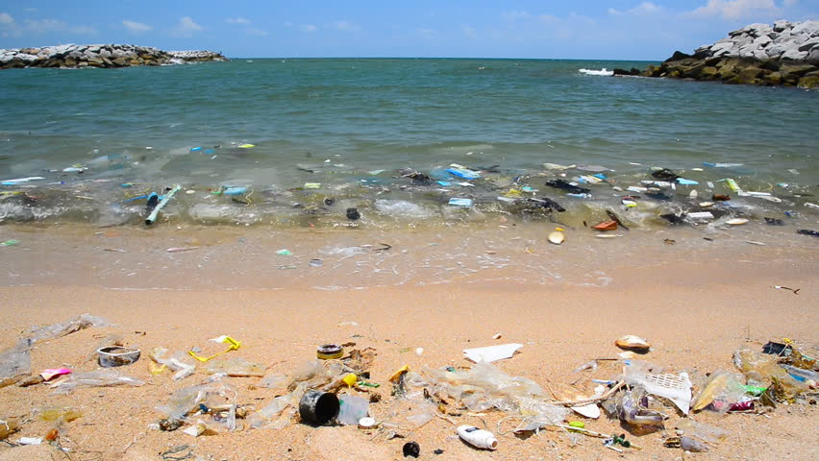
What is Wrong With This Picture?
https://www.shutterstock.com/video/clip-9500465-stock-footage-pollution-on-the-beach-of-tropical-sea.html?src=rel/13104191:1/gg

Slide 3
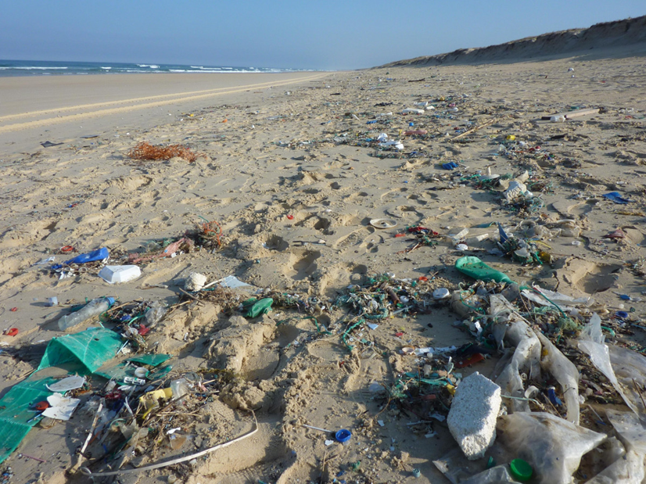
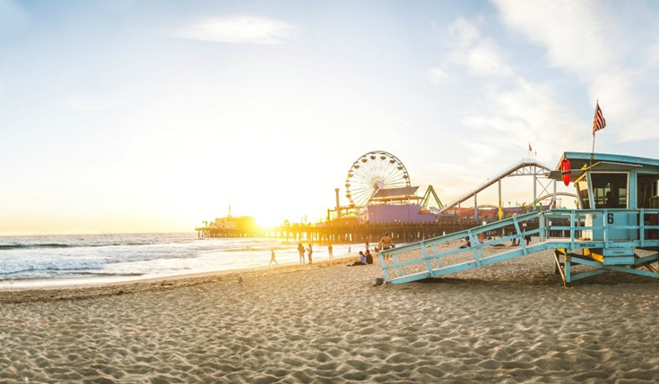
How Should a Beach Look?
https://supervisorkuehl.com/wp-content/uploads/2017/06/Heal-the-Bay-Report-Card-1080x630.jpg

Slide 4

Who Made All This Waste and
How Do You Think it Ended Up at Beach?
  Chart student responses
    Who?
    How?

Slide 5
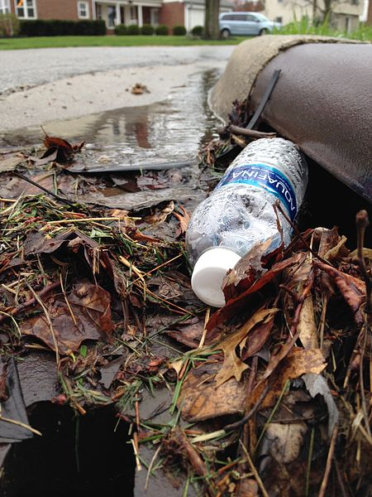
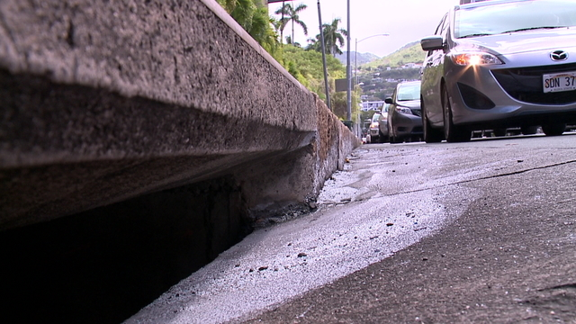
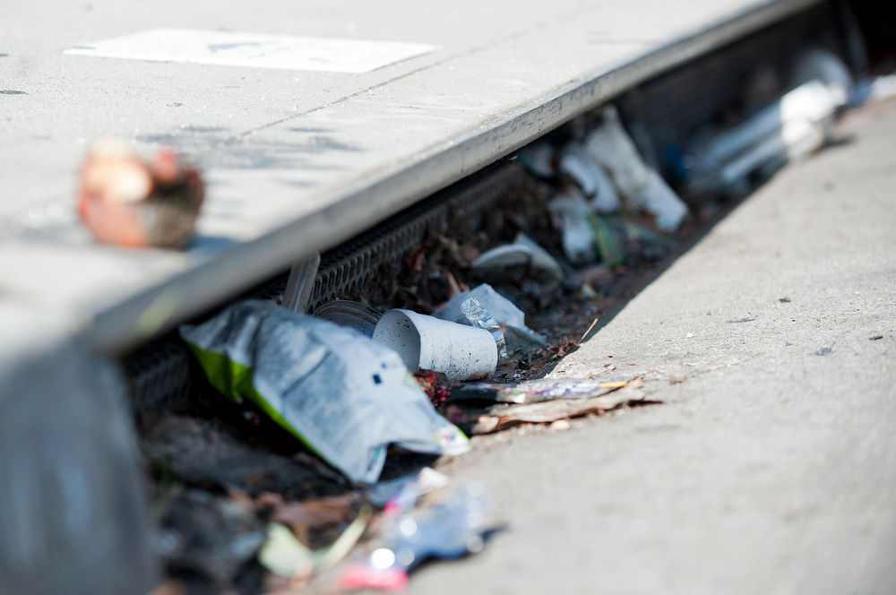
What are Pollutants?
Any substances that can hurt the environment.
What is Stormwater Pollution?
Excess water that runs down storm drains
carrying pollutants from the environment.
https://commons.wikimedia.org/wiki/File:%22I_prefer_the_bottled_stuff,%22_said_the_storm_drain._(25565964563).jpg
https://www.khon2.com/news/local-news/contractor-caught-dumping-waste-water-down-storm-drain/1025784152
https://www.scpr.org/news/2018/07/17/84816/l-a-county-voters-to-decide-on-new-stormwater-tax/

Slide 6






Where Does Our Water Come From?

Slide 7
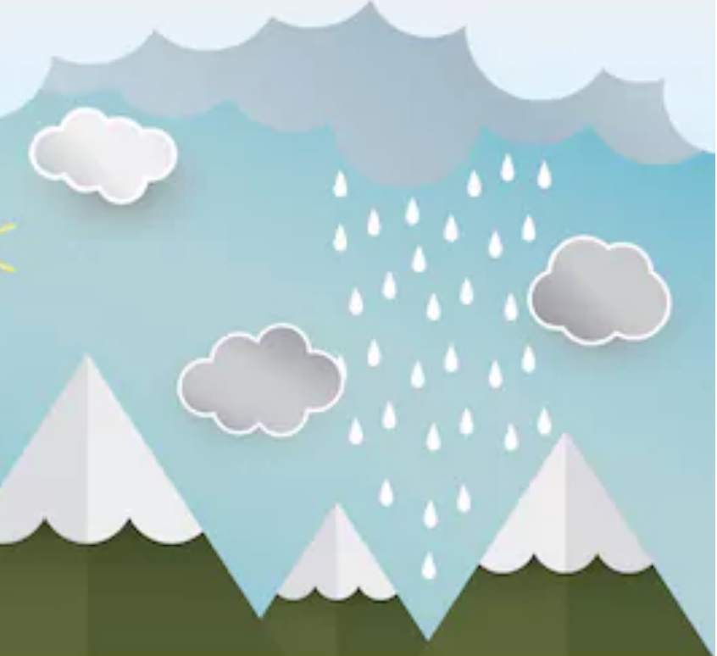
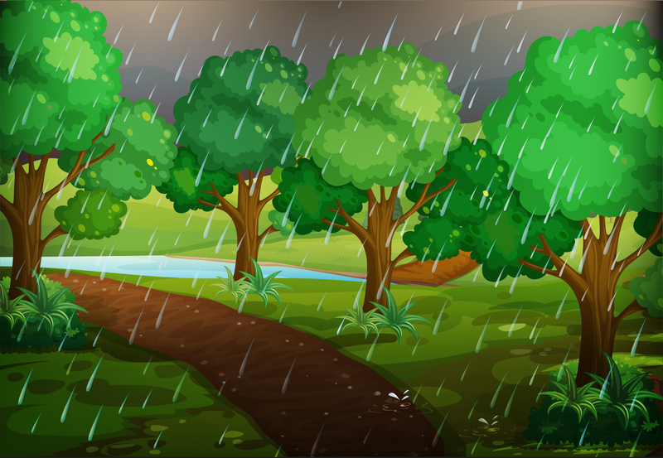
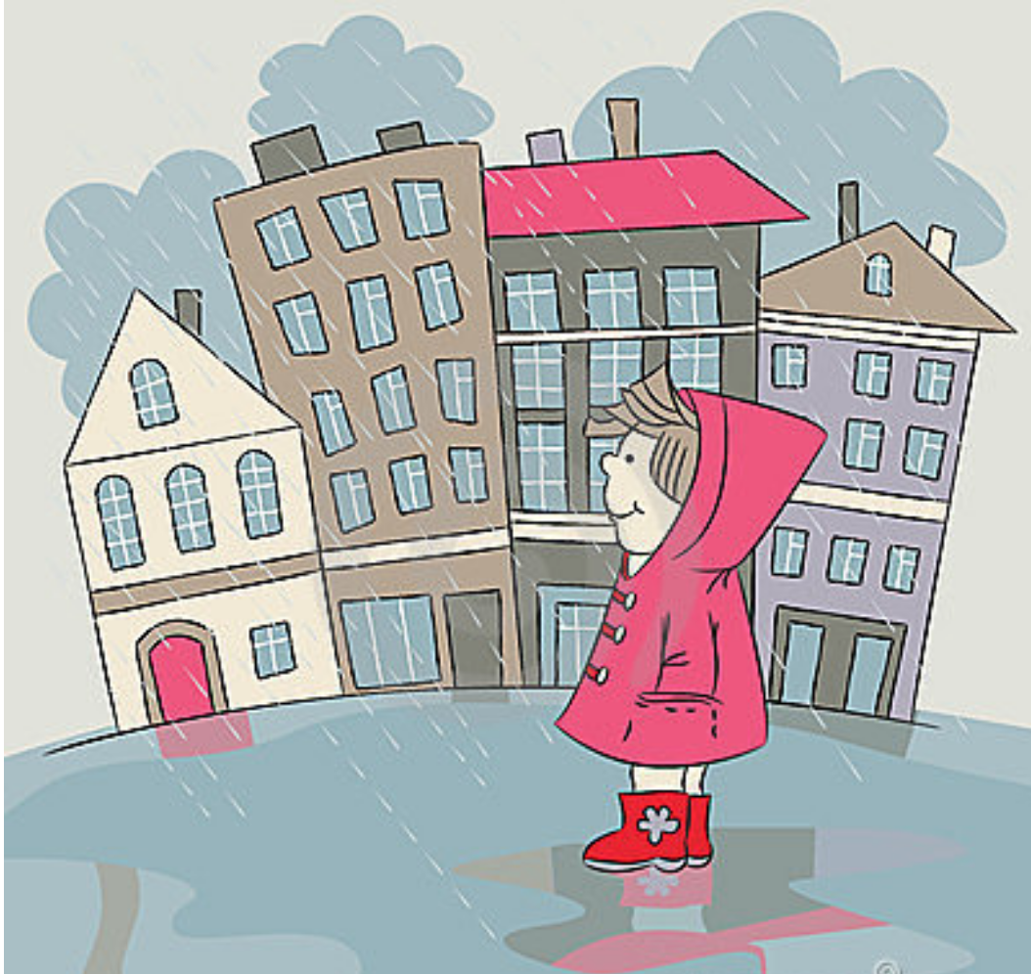
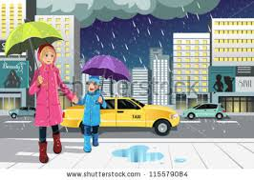
Where Does it Come From?
Where Does it Go?
https://www.shutterstock.com/image-vector/paper-art-rain-sun-mountain-cloud-655089091
https://www.dreamstime.com/illustration/forest-scene-rainy-day.html
https://www.dreamstime.com/royalty-free-stock-photos-rain-city-image23524878#res170862

Slide 8
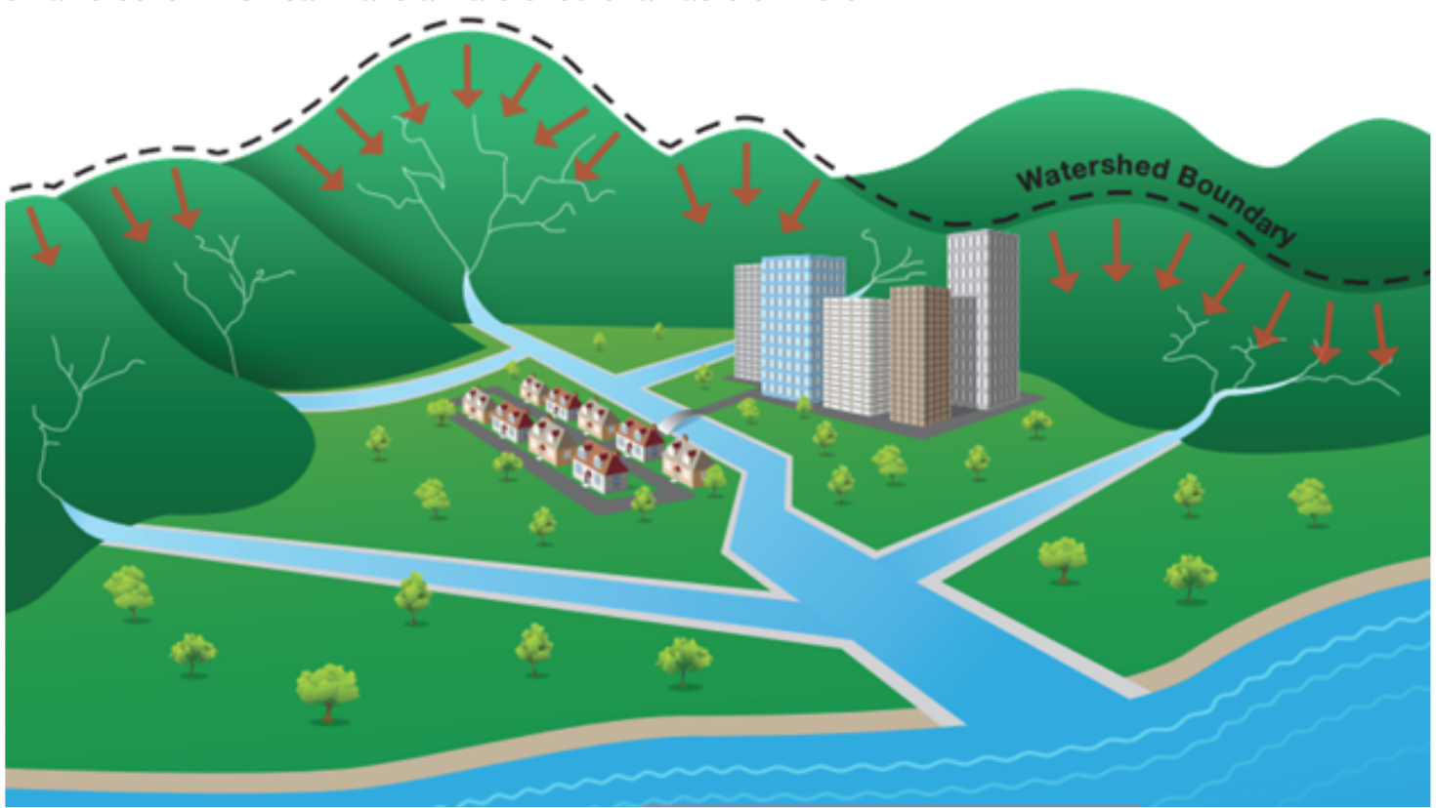
WHAT IS A WATERSHED?
A watershed is an area of land that contains a group of streams and rivers that all drain into a single body of water, such as a larger river, a lake, or an ocean.
S8
http://www.lastormwater.org/about-us/about-watersheds/

Slide 9
Initial Watershed Model
In your Science Notebook, draw a model of the watershed we just observed.
Remember to add labels.

Slide 10
Rainwater in a Watershed Model
Add arrows in your watershed model that show the direction the rain water flowed through the watershed.

Slide 11
Rainwater in a Watershed Model
Answer the following questions under your model:
Where does our water come from?
What is a watershed?
When it rains, where does the rainwater go?

Slide 12
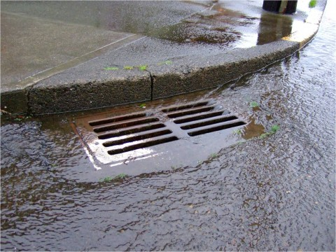
Rainwater in City Streets
When it rains in the streets around your house, where does the water go?
http://www.duncanville.com/departments/public-works/divisions/stormwater/street-stormwater-drain/

Slide 13
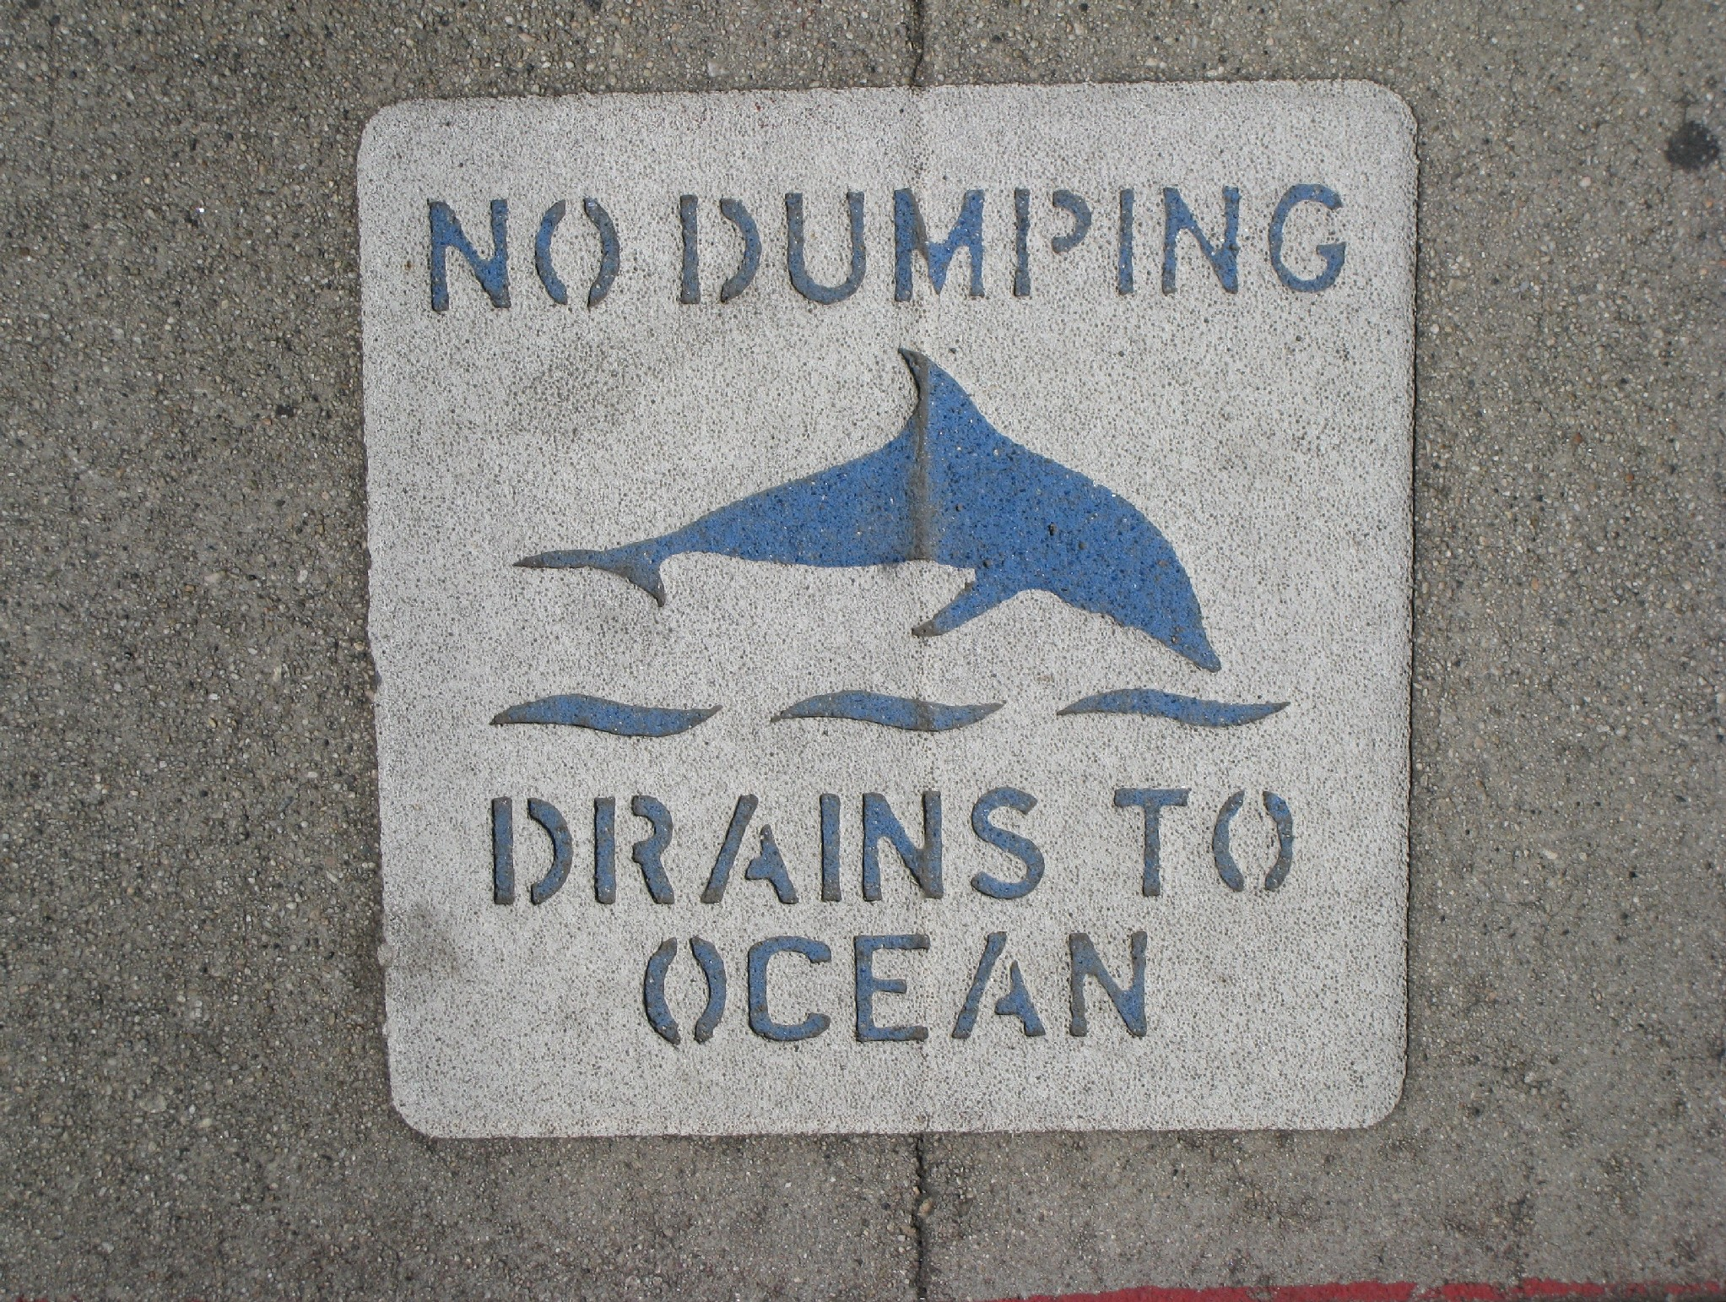
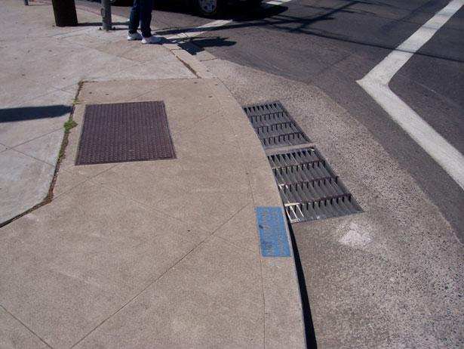
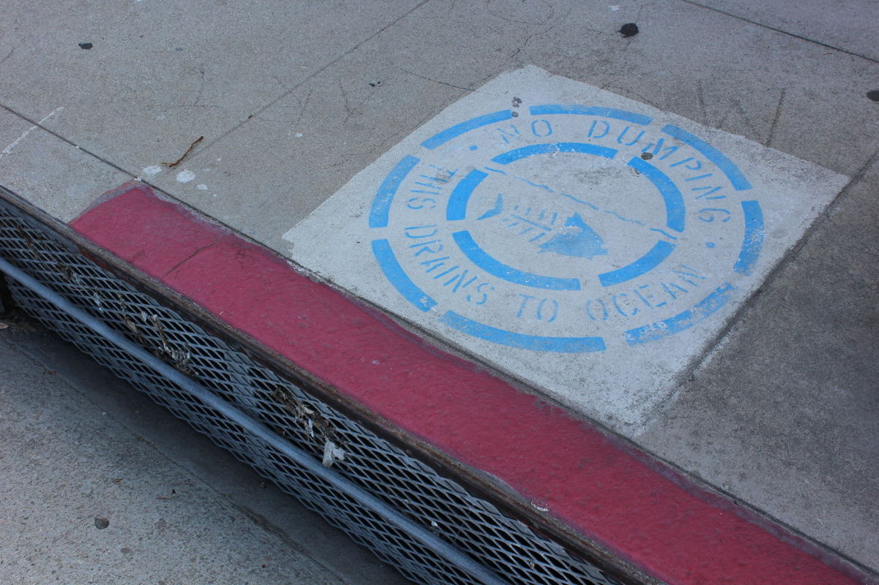
Storm Drain Inlets
(Catch Basins)
http://www.watereducation.org/aquafornia-news/innovative-ideas-southern-california-practical-projects-and-techniques-show-how
http://tbrnews.com/news/hermosa_beach/hermosa-beach-calls-on-community-to-help-stencil-storm-drains/article_263b58c6-ef90-11e4-b87c-53412c3a2f3c.html
http://www.kabbara.net/?page_id=468

Slide 14
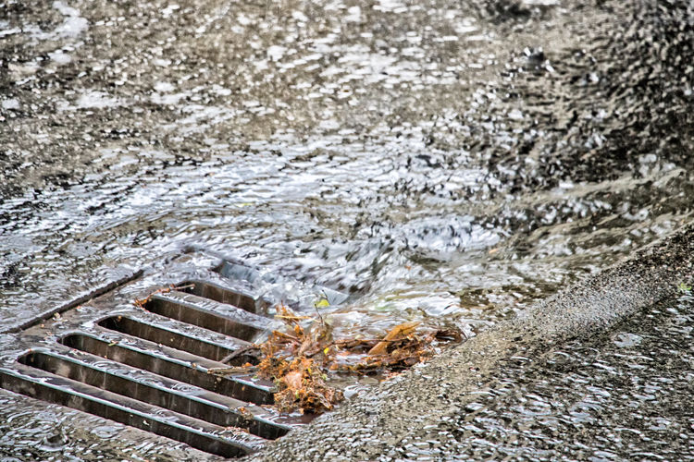
Rainwater in City Streets
Where does rainwater go to from the storm drain inlets or catch basins?
Where does it go to from creeks, streams and rivers? (Remember what we learned from the watershed model!)
https://kfiam640.iheart.com/content/2018-07-17-la-county-approves-stormwater-tax-for-november-ballot/#

Slide 15
Rainwater in City Streets
What do you think happens to pollutants in our street when it rains?
Where do pollutants end up?
https://www.scpr.org/news/2018/07/17/84816/l-a-county-voters-to-decide-on-new-stormwater-tax/

Slide 16
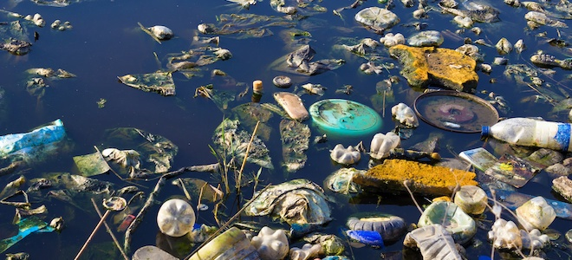
What is Stormwater Pollution?
Excess water that runs down
storm drain inlets (or catch basins) carrying pollutants from the environment.
Credit: iStockphoto
https://www.doityourself.com/stry/what-are-the-effects-of-water-pollution-on-the-environment

Slide 17
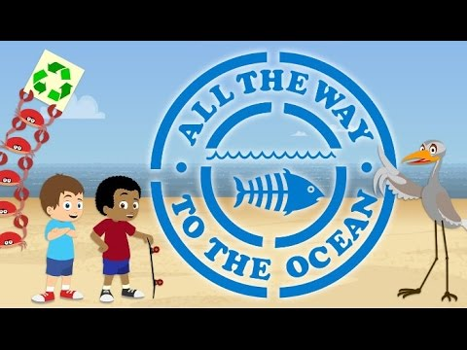
All the Way to the Ocean
Notes:
Youtube video link: https://www.youtube.com/watch?time_continue=5&v=sZW2ByM623g

Slide 18
School Community Field Trip
We will take a field trip around our school.
Follow the directions in the map given to you.
Look for storm drain inlets (or catch basins) and mark them on your map with a blue checkmark.
Take note of any pollutants that can end up going down the storm drain inlets (or catch basins).
    What do you think will happen to them?

Slide 19
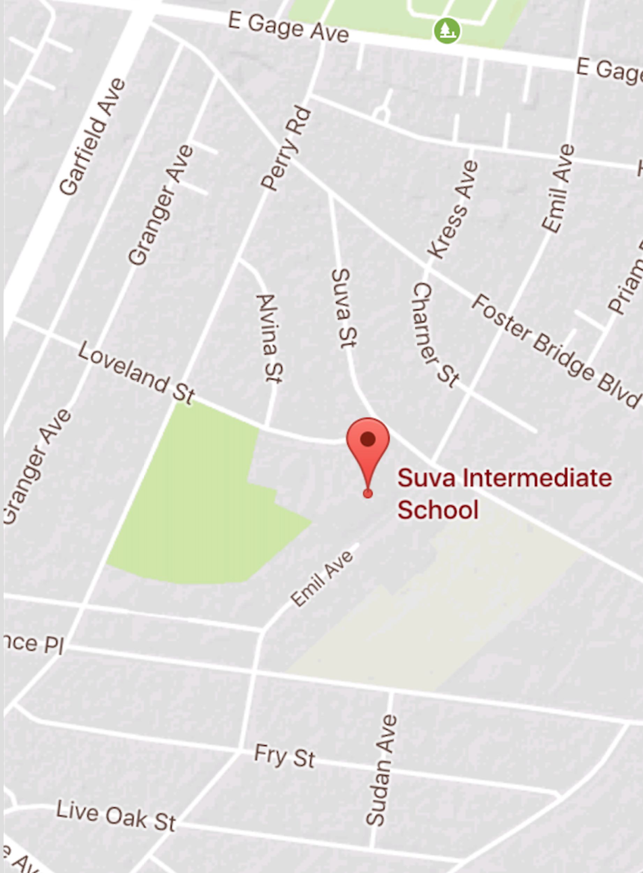




Field Trip Map
KEY
Route and
direction of field trip
Storm drain inlet (or catch basin) location
SAMPLE

Slide 20
Field Trip Disscussion Questions
How many storm drain inlets/catch basins did we see?
What types of waste or pollutants did you notice on our streets?
What do you think will happen to all the waste we found?

Slide 21
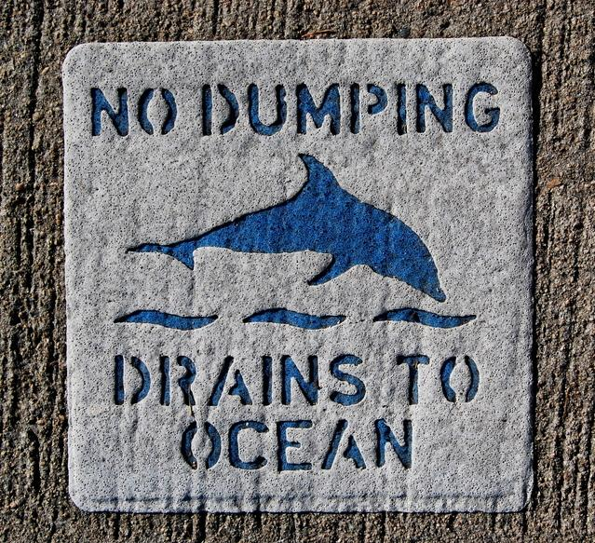
Public Service Announcment:
“How to Prevent Stormwater Pollution”
With a group, write a letter, draw a poster or put on a play that will raise community awareness about keeping the streets clean so water
pollution doesn’t happen.
https://www.freeimages.com/photo/ecology-2-1309067

